Slide 1
Bedford Youth Soccer
Coaches Meeting Fall 2020
K-2nd Grade

Slide 2
Agenda
Mission of Bedford Youth Soccer
COVID Guidelines and Modified Play
Field and Personal Spacing
Face Masks
Soccer Sessions/Games/Overview
COVID Tracking Procedures
Medical Release and Cori
Field Assignment
Equipment
Other Notes / Coaching Resources

Slide 3
Fall 2020 Soccer goal:
Mission of Bedford Youth Soccer
Bedford Soccer's mission is to serve the children and achieve these goals:
1. All children can play. We provide opportunities for children of all skill levels to learn and
play the game.
2. Fun, learning, enjoyment. Having fun, learning and enjoying the game are always more
important than winning.
3. The game is the best teacher. Effective practice combines age-appropriate skill
development with time spent playing the game.
4. Sportsmanship and teamwork. Learning and demonstrating excellent sportsmanship and
teamwork are key parts of learning soccer.
5. Positive coaching. Coaching must always be positive, supporting children's enjoyment of
the game, strengthening children's self esteem and creating a positive environment.
6. Positive spectatorship. Parents and spectators play a crucial role in providing a positive
experience for the children. Positive spectators show respect for and appreciation of the
game, the coaches, and the players on all teams.
To build a healthy community by providing soccer to as many children as possible in a fun and safe environment.

Slide 4
COVID Guidelines
Guidelines dictated largely by state rules and re-opening phase
Currently we are in Phase 3 – which allows inter-team games under modified rules
Modified Rules:
Must try to generally keep apart 6 ft as much as possible
Must avoid deliberate physical contact
Must limit situations that lead to accidental physical contact

Slide 5
Modifications made to the game:
NOT Permitted NO Heading NO Slide Tackling NO Shoulder to Shoulder NO Throw Ins NO Corner Kicks NO Walls NO Drop Balls
What you CAN Do Block Tackle Kick Ins (no offsides, 10 yds) Corner Kick Ins (10 yds, cannot go into the penalty area. Punting Quick restarts
Balls should be sanitized if they touch player’s face or if hand touches face and then ball (goalie). Need a clean back up ball at the ready to swap in.

Slide 6
IF there ever was a year to Yell “SPREAD out!”…
As a Coach
DON’T:
Allow physical normal soccer to occur
Spend the whole practice screaming “DON’T TOUCH EACH OTHER!”
Encourage bad soccer habits by trying to avoid contact at all costs
DO:
Encourage the kids to space out via good soccer habits
Drills that help kids keep distance from each other
Encourage playing for the ball with their feet only
Encourage good defensive and offensive position on the field
Encourage communication, passing and 1v1 defense

Slide 7
IF there ever was a year to Yell “SPREAD out!”…
Alternatives to “DON’T TOUCH EACH OTHER!”
“Find your space”
“Get open”
“Make yourself available”
“Spread out”
“Use the whole field”

Slide 8
Mind the GAP
Field Spacing
25 players max on field for practices or games
Assuming standard size field for their age group.
Fields must be 14 feet apart (minimum)
People Spacing
Max of ONE spectator per player
Coaches must distance 6 feet from players at all times
Players should distance from each other when possible on the field.
No hand shakes, fist bumping
Spectators must remain 6 feet away from sideline to keep distancing from players and coaches.
Spectators must remain 6 feet away from other spectators at all times and wear a mask at all times.

Slide 9
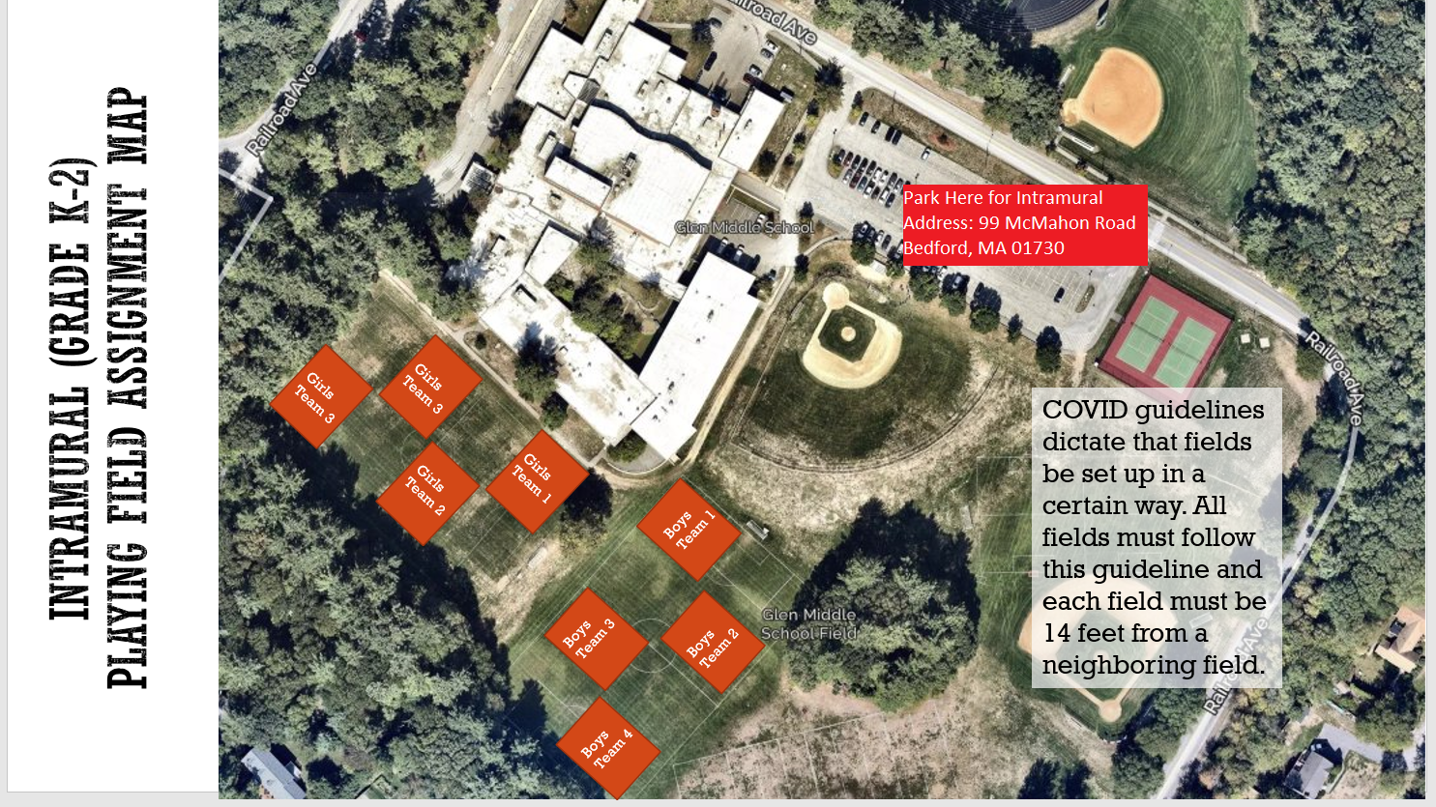
Field Setup

Slide 10
Its all about the Face Masks…
Facemasks must be worn by players at all times
Facemasks must be worn by coaches at all times
Facemasks must be worn by spectators at all times
Players may only use masks that wrap behind the ears – no gaiter mask!
The COVID-19 coordinator is responsible for making sure that all players/coaches/spectators are abiding by the facemask rules. If someone is in non-compliance the COVID-19 coordinator for that team should address the parent/spectator and if they do not comply the COVID Coordinator should contact the Recreation Department to report non-compliance.
Arguments and altercations regarding mask wear are to be avoided – just report it! Do not escalate the situation by applying repeated pressure.
Non compliance of facemask and distancing rules could result in suspension of field permits and program by the Town of Bedford.

Slide 11
Gimme a (Mask) Break!
How do you drink water with a mask on?

Slide 12
Gimme a (Mask) Break!
How do you drink water with a mask on?
YOU DON’T!
Kids will remove their mask to have water breaks.
Kids must maintain 6ft distance from each other when this happens.
How do kids get water break?
Each kid should have his/her own “Cone”-dom
Place cones at least 6 ft apart in a line on the side of the field
As kids come in, assign a kid a cone and have them put all their stuff next to that cone
As long as a kid puts a foot on the cone, mask can be removed to drink water
No one shall infringe on the sovereign boundary of a Cone-dom – (6ft boundary)
Trick: Place the cones where people and soccer balls are unlikely to cross

Slide 13
General Soccer Session
10 minutes before session start
Coaches arrive and setup Cone-dom and any drills
Players may not be dropped off early!
5 minutes before session start
Players begin to arrive
Coach/Covid Coordinator greets each player, verbally verifies no symptoms and assigns the kid to a coach-group and a Cone-dom
Session start
Start drills / practice portion of session (30 mins for K, 45 for 1st, 45-60 for 2nd)
~30 minute scrimmages
Start games / scrimmage
Session end time
Players leave field immediately – absolutely no “extra” shots/practice/mingling
Coaches only collect all equipment
10 minutes after session end time
Coaches need to vacate the field*
*While coaches should leave the field, coaches should never leave the facility before all kids have been picked up

Slide 14
Session PLans
Session Plans will be provided by Proformance
Typically 3 drills, ~8-10 minutes per with water breaks
Plans will be physical distance friendly
Once plans are available, please think about how to account for COVID, e.g.
For shooting drills, have a coach or parent stationed behind the net to nudge balls out with their feet so players aren’t having to dig around in the net
For drills that would normally have kids standing in line, space cones 6 ft apart to identify where they should wait
Please use the drills provided
Ensures all players focus on the same skills each week
If you need more bodies to make these run smoothly, recruit parents as needed!

Slide 15
Scrimmages
3v3 inter-team scrimmages
Half the players will stay at their “home” field with one coach, the other half will travel to another field with the 2nd coach
Critical to have 2 coaches each week to manage each team in the scrimmage – if a coach will miss a week, a parent will have to step in.
Scrimmages will all use small nets so no goalies, even in grade 2
Restarts by kick-in only
Balls should be retrieved without picking up the ball
At every restart, players need to be 6 feet away from both teammates and opponents
Don’t keep score
Balance teams to the best of your ability

Slide 16
COVID-19 Tracing and procedures
When a parent/guardian brings a child to the first practice/scrimmage the child MUST bring a signed monitoring sheet required by the Town of Bedford. If a child does not have a sheet they will not be permitted to remain at soccer. Coaches will be provided extra monitoring sheets in case they forget.
By signing the monitoring sheet the parent is agreeing that they will keep their child home if they had answered yes to any of the monitoring questions.
Each team should have a COVID-19 Coordinator and must take attendance at all events and keep this record through the season.
If a child, coach or spectator tests positive the COVID-19 coordinator should contact Nikki or Amy at the Bedford Recreation Department immediately who will contact the Bedford Board of Health.

Slide 17
Agreement for Symptom Monitoring for the Town of Bedford
*must be turned in once at the start of the season.
Forms will be emailed to parents before the start of the season.

Slide 18
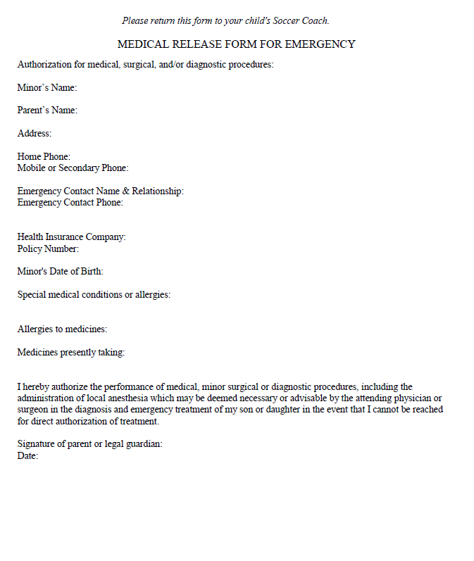
Medical Release Form
*Coaches keep forms in their team bag all season.
Forms will be emailed to parents before the start of the season.

Slide 19
CORI
Town of Bedford CORI form is required for all coaches/coordinators. CORI forms should be emailed to Nikki Taylor at ntaylor@bedfordma.gov

Slide 20
Equipment/Equipment Distribution
Grade K-2:
Equipment pick up is Friday, October 1 from 5:00-6:00 PM outside of 12 Mudge Way (Recreation Department)
12 Mudge Way will be closed the entire season. If you cannot make these pick up tiems please contact Nikki Taylor. If you need equipment replenished please contact Nikki Taylor at the Bedford Recreation Department.
Each coach will receive hand sanitizer and sanitizing wipes in their equipment bag.
Each player will receive a pinnie that they should be given at the first practice. Pinnies will be taken home by players each practice and brought back for their dedicated use for the season.
Shared equipment must be sanitized after each use.
Benches should not be used this season.

Slide 21
Additional Information
Communication with parents throughout the season is key.
Attitude: players follow the coaches example when it comes to attitude
Players may not wear jewelry
Weather cancellation:
By 7:00 AM (morning sessions)
By 11:00 AM (afternoon sessions)
If there is a weather cancellation it is the coaches responsibility to notify their players.
COVID checklists will be made available on the website
Coach
COVID Coordinator
Parent

Slide 22
Coaching resources
Visit www.bedfordyouthsoccer.org for coaching resources
Nikki Taylor- Bedford Youth Soccer Liaison
Jason Rotella- Chair, Bedford Soccer Association
For weekend field closures/program cancellation due to weather please check our website at www.bedfordrecreation.org
Intramural Coordinators:
Intramural Coordinators
Kevin Dickert
Jay Hadden
Damien Savoie
Age Group Coordinators (Grade 3-8):
Girls Grade 3: Jason Rotella
Girls Grade 4: Kevin Dickert
Girls Grade 5: Kostia Franklin
Girls Grade 6-8: Tara Capobianco
Boys Grade 3: Annemarie Silver
Boys Grade 4: Jason Rotella
Boys Grade 5: Mary Gallant
Boys Grade 6-8: Sean Walton

