Slide 1
Bedford Youth Soccer
Travel Coaches Meeting Spring 2021
3rd-8th Grade

Slide 2
Agenda
Mission of Bedford Youth Soccer
COVID Guidelines
Field and Personal Spacing
Face Masks
Soccer Sessions/Games/Overview
COVID Tracking Procedures
Medical Release and Cori
Fields
Equipment
Other Notes / Coaching Resources

Slide 3
Spring 2021 Soccer goal:
Mission of Bedford Youth Soccer
Bedford Soccer's mission is to serve the children and achieve these goals:
1. All children can play. We provide opportunities for children of all skill levels to learn and
play the game.
2. Fun, learning, enjoyment. Having fun, learning and enjoying the game are always more
important than winning.
3. The game is the best teacher. Effective practice combines age-appropriate skill
development with time spent playing the game.
4. Sportsmanship and teamwork. Learning and demonstrating excellent sportsmanship and
teamwork are key parts of learning soccer.
5. Positive coaching. Coaching must always be positive, supporting children's enjoyment of
the game, strengthening children's self esteem and creating a positive environment.
6. Positive spectatorship. Parents and spectators play a crucial role in providing a positive
experience for the children. Positive spectators show respect for and appreciation of the
game, the coaches, and the players on all teams.
To build a healthy community by providing soccer to as many children as possible in a fun and safe environment.

Slide 4
COVID Guidelines
Guidelines dictated largely by state rules and re-opening phase
Currently we are in Phase 4 Step 1 (Updated March 22, 2021)
Soccer is considered a MODERATE Risk Sport
Phase 4 Step 1 + MODERATE = inter-team games (no modifications!)

Slide 5
COVID Guidelines
Do encourage physical distancing when possible outside of the game
Shared equipment (cones, goals etc) should only be handled by coaches
All equipment must be sanitized by coaches between practices.
Players should bring their own equipment and avoid sharing
i.e. Goalie gloves should not be shared if possible
Coaches must keep attendance at all games and practices
Paper or digital record is required!
No handshakes, high fives, fist bumps etc

Slide 6
Mind the GAP
Field Spacing
Guidelines for “number of players on a field at once” still exist
Practice location and games times have been setup to fall under these guidelines
In general, don’t fill a regulation size field with more then 2 teams
People Spacing
Max of 2 spectators per player (not including siblings)
Spectators are generally expected to be guardians
Coaches must distance 6 feet from players at all times
No hand shakes, fist bumping
Spectators must remain 6 feet away from sideline to keep distancing from players and coaches.
Spectators must remain 6 feet away from other spectators at all times and wear a mask at all times.

Slide 7
Its all about the Face Masks…
Facemasks must be worn by players at all times
Facemasks must be worn by coaches at all times
Facemasks must be worn by spectators at all times
The COVID-19 coordinator is responsible for making sure that all players/coaches/spectators are abiding by the facemask rules. If someone is in non-compliance the COVID-19 coordinator for that team should address the parent/spectator and if they do not comply the COVID Coordinator should contact the Recreation Department to report non-compliance.
Arguments and altercations regarding mask wear are to be avoided – just report it! Do not escalate the situation by applying repeated pressure.
Non compliance of facemask and distancing rules could result in suspension of field permits and program by the Town of Bedford.

Slide 8
Gimme a (Mask) Break!
How do you drink water with a mask on?

Slide 9
Gimme a (Mask) Break!
How do you drink water with a mask on?
YOU DON’T!
Kids will remove their mask to have water breaks.
Kids must maintain 6ft distance from each other when this happens.
How do kids get water break?
Each kid should have his/her own designated area
Place cones at least 6 ft apart in a line on the side of the field
As kids come in, assign a kid a cone and have them put all their stuff next to that cone
As long as a kid touches the cone, mask can be removed to drink water
No one shall infringe on a persons boundary – (6ft boundary)
Trick: Place the cones where people and soccer balls are unlikely to cross

Slide 10
Current Rule book
https://bays.org/book/playing-rules-and-regulations-bays-soccer-competition

Slide 11
Referees
ZERO TOLERANCE POLICY:
All individuals responsible for a team and all spectators shall support the referee. Failure to do so will undermine the referee’s authority and has the potential of creating a hostile environment for the players, the referee, and all the other participants and spectators.
Consequently, BAYS has adopted and modified the following rules:
No one, except the players, is to speak to the referee during or after the game. Exceptions: Coaches may ask questions before the game, call for substitutions and point out emergencies during the game, or respond to the referee if addressed.
Absolutely no disputing calls, during or after the game, no remarks to the referee to watch certain players or attend to rough play. NO YELLING at the referee, EVER, and no criticism, sarcasm, harassment, intimidation, or feedback of any kind during or after the game.
Violators may be ejected and are subject to disciplinary action by the BAYS Sportsmanship Review Committee.
If coaches or spectators have questions regarding particular calls, rules, or a referee, or wish to give feedback regarding a referee, please contact the town soccer club referee’s coordinator for the game in question, or contact the BAYS Referees Representative at http://www.bays.org
The referee coordinator is Bob Goodman (goodmanreferee@gmail.com)
Bob is responsible for the training, coordination and scheduling of referees.
If there is an issue concerning a referee you should be reaching out to Bob.
How to confirm your referee?
For home games, Head Coaches should be reaching out to their scheduled referee a few days before the game to confirm that they are aware of the game. If an issue arises that will give us time to trouble shoot.
If your game is cancelled you MUST let your referee know AND confirm that they have received the message. Please ask for confirmation.
Referees are often young and learning too, they are your neighbors! Please be kind and helpful to them whenever possible. A referee shortage is not a problem that we want.
Manage your parents and let them know the expectations from the start. Do not allow parents to harass or talk to the referees. If there is a pattern please contact Nikki so she can handle it.
Zero tolerance violations often have consequences that range from apology letters to suspension of games. Bedford aims to have ZERO Zero Tolerance Violations from both parents, coaches and players.

Slide 12
Games
Games begin on Saturday, April 10.
We are unapologetic about maintaining equal playing time in all positions, even goal. We are a town program, not a club program. We can play to win without sacrificing those principals
Fun: the top reason that kids stop playing is lack of fun
You can find your team’s game schedule at www.bays.org
Match Day Check List
Referee
Corner Flags
Goals
Inspect the field conditions
Rosters-2 official copies for each game. Official BAYS roster (different from roster announcement) will be emailed to you. Print a bunch of copies for your bag.
Reporting results: Report your results to your BAYS section leader after your game. This is important so records are accurate, especially for misplaced teams.
Misplaced teams: If you are overwhelmed or overwhelming there is a possibility of moving after week 5. We will monitor. Talk to your AGC.
No heading for anyone except grades 7/8
BAYS guidelines for goal differential
Max goal differential of 5 there is a good presentation on the BAYS website on how to manage. If you are not managing this we will hear about it.

Slide 13
games
Please Do:
Contact your opposing team’s coach by Wednesday before game
Verify your referee is coming to the game by Wednesday before the game
Verify your team’s availability for games over Spring Break and Memorial Day Weekend
Pre-pone games if you will not have enough players
Communication with parents throughout the season is key.
Attitude: players follow the coaches example when it comes to attitude
Take care of the fields. Move the goals out of the goal boxes for practices.
Players may not wear jewelry
Weather cancellation:
By 7:00 AM (morning sessions)
By 11:00 AM (afternoon sessions)
If there is a weather cancellation it is the coaches responsibility to notify their players.

Slide 14
General Soccer Practice
10 minutes before session start
Coaches arrive and setup kid belongings area and any drills
Players may not be dropped off early!
5 minutes before session start
Players begin to arrive
Coach greets each player, verbally verifies no symptoms and assigns the kid to an area for that belongings
Session start
Start drills / practice portion of session
40-60 minutes after session start
Start games / scrimmage
Session end time
Players leave field immediately – absolutely no “extra” shots/practice/mingling
Coaches only collect all equipment
10 minutes after session end time
Coaches leave field

Slide 15
COVID-19 Tracing and procedures
When a parent/guardian brings a child to the first practice/scrimmage the child MUST bring a signed monitoring sheet required by the Town of Bedford. If a child does not have a sheet they will not be permitted to remain at soccer. Coaches will be provided extra monitoring sheets in case they forget.
By signing the monitoring sheet the parent is agreeing that they will keep their child home if they had answered yes to any of the monitoring questions.
Each team should have a COVID-19 Coordinator and must take attendance at all events and keep this record through the season.
If a child, coach or spectator tests positive the COVID-19 coordinator should contact Nikki or Amy at the Bedford Recreation Department immediately who will contact the Bedford Board of Health.

Slide 16
Agreement for Symptom Monitoring for the Town of Bedford
*must be turned in once at the start of the season.
Forms will be emailed to parents before the start of the season.

Slide 17
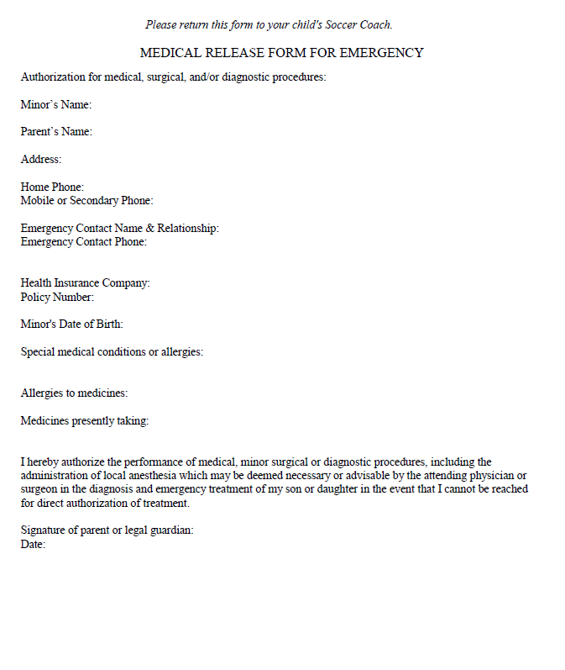
Medical Release Form
*Coaches keep forms in their team bag all season.
Forms will be emailed to parents before the start of the season.
This form will also include a zero tolerance pledge.

Slide 18
CORI
MYSA Cori process has been emailed to all coaches.
Coaches who have not completed all requirements will not be able to attend any practices until they are cleared by Nikki.
We will not be able to add your team roster until you have completed the process.
CREDENTIALS- If you have completed all requirements your coach credential will be in your team bag by equipment pick up. If you still have things to complete we will need to schedule a time for you to pick it up once you are completed.
Please contact Nikki with any questions.

Slide 19
fields
Protect our fields
Move goals for practices to avoid wear and tear to the goal mouths
Moving the goals out of the goal mouths will also help the Public Works department mow inside of the goals
Make sure the goals are anchored
Avoid wet areas, damage to the field takes longer to fix than it does to create
If you notice an issue with a field or goal please let Nikki know as soon as possible so she can address it.

Slide 20
Travel Field assignments
Boys
Age Group | Practice Location | Games
Boys Grade 3- Carroll | Lane School | Lane School
Boys Grade 3- Kresser | Lane School | Lane School
Boys Grade 4- Kennedy | Springs Brook Park | Springs Brook Park
Boys Grade 5/6- Rotella | South Road (Back Field) | South Road (Back Field)
Boys Grade 5/6- Dreyfus | South Road (Back Field) | South Road (Back Field)
Boys Grade 5-Gallant | South Road (Front Field) | South Road (Front Field)
Boys Grade 7/8- Goss | Will rotate between Turf and Liljegren (scheduled will be emailed) | Will rotate between Turf and Liljegren Field
Boys Grade 7/8- Kruger | Will rotate between Turf and Liljegren (scheduled will be emailed) | Will rotate between Turf and Liljegren Field
Boys Grade 7/8- Walton | Will rotate between Turf and Liljegren (scheduled will be emailed) | Will rotate between Turf and Liljegren Field
Grades 3-8
Two practices per week and one game per weekend
Games begin April 10 and end June 12
Girls Practice Monday/Thursday
Boys Practice Tuesday/Friday
Girls
Age Group | Practice Location | Games
Girls Grade 3-Duffy | Lane School | Lane School
Girls Grade 3- Nair | Lane School | Lane School
Girls Grade 4-Dickert | Springs Brook Park | Springs Brook Park
Girls Grade 4- Dadah | Springs Brook Park | Springs Brook Park
Girls Grade 5/6-Thacore | South Road (Back Field) | South Road (Back Field)
Girls Grade 5-6- Walton | South Road (Front Field) | South Road (Front Field)
Girls Grade 7/8- Luongo | BHS Turf Field Mondays: 6-7:30 PM Thursdays: 7:30-9 PM | BHS Turf Field
Girls Grade 7/8- Shelton | BHS Turf Field Mondays: 6-7:30 PM Thursdays: 7:30-9 PM | BHS Turf Field

Slide 21
Equipment/Equipment Distribution
GRADE 3-8:
Equipment pick up is Saturday, March 27 from 9:00-10:00 AM at Springs Brook Park. Drive all the way down to the pond.
Each team will receive hand sanitizer, sanitizing wipes and an electronic whistle. Each player will receive a pinnie that they should be given at the first practice. Pinnies should be taken home by players each practice and washed and brought to the next practice.
Shared equipment must be sanitized after each use.
Benches should not be used this season.

Slide 22
Coaching resources
Visit www.bedfordyouthsoccer.org for coaching resources
Nikki Taylor- Bedford Youth Soccer Liaison
Jason Rotella- Chair, Bedford Soccer Association
For weekend field closures/program cancellation due to weather please check our website at www.bedfordyouthsoccer.org
Age Group Coordinators (Grade 3-8):
Girls Grade 3: Annemarie Silver
Girls Grade 4: Jason Rotella
Girls Grade 5/6: Damien Savoie
Girls Grade 7/8: Heath Luedde
Boys Grade 3: Mary Gallant
Boys Grade 4: Kostia Franklin
Boys Grade 5/6: Sean Walton
Boys Grade 7/8: Kevin Dickert

