Slide 1
Bedford Youth Soccer
Intramural Soccer
Coaches Meeting
Spring 2021

Slide 2
Agenda
Mission of Bedford Youth Soccer
COVID Guidelines and Modified Play
Field and Personal Spacing
Face Masks
Soccer Sessions/Games/Overview
COVID Tracking Procedures
Medical Release and Cori
Field Assignment
Equipment
Other Notes / Coaching Resources

Slide 3
Fall 2020 Soccer goal:
Mission of Bedford Youth Soccer
Bedford Soccer's mission is to serve the children and achieve these goals:
1. All children can play. We provide opportunities for children of all skill levels to learn and
play the game.
2. Fun, learning, enjoyment. Having fun, learning and enjoying the game are always more
important than winning.
3. The game is the best teacher. Effective practice combines age-appropriate skill
development with time spent playing the game.
4. Sportsmanship and teamwork. Learning and demonstrating excellent sportsmanship and
teamwork are key parts of learning soccer.
5. Positive coaching. Coaching must always be positive, supporting children's enjoyment of
the game, strengthening children's self esteem and creating a positive environment.
6. Positive spectatorship. Parents and spectators play a crucial role in providing a positive
experience for the children. Positive spectators show respect for and appreciation of the
game, the coaches, and the players on all teams.
To build a healthy community by providing soccer to as many children as possible in a fun and safe environment.

Slide 4
Program Dates, Times and Locations
Program Dates: 4/10-6/12 (no soccer 5/31)
Grade 2: 8:45-10:15 AM (Boys: J Field/Girls: Plateau Field)
Grade K: 10:45-11:45 AM (Boys: J Field/Girls: Plateau Field)
Grade 1: 12:30-1:45 PM (Boys: J Field/Girls: Plateau Field)
The program will take place at the JGMS Field Complex. 99 McMahon Road. You can park in the front or back of the school.

Slide 5
COVID Guidelines
Modified Requirements:
Must try to generally keep apart 6 ft as much as possible
Try to avoid physical contact if possible
Masks must be worn by players, spectators and coaches at all times with the exception of water breaks. Water breaks must be physically distant.

Slide 6
Spread out
As a Coach
DO:
Encourage the kids to space out via good soccer habits
Drills that help kids keep distance from each other
Encourage good defensive and offensive position on the field
Encourage communication, passing and 1v1 defense
DON’T:
Spend the whole practice screaming “DON’T TOUCH EACH OTHER!”
Encourage bad soccer habits by trying to avoid contact at all costs

Slide 7
Spread out
Alternatives to “DON’T TOUCH EACH OTHER!”
“Find your space”
“Get open”
“Make yourself available”
“Spread out”
“Use the whole field”

Slide 8
Other modifications
Coaches should distance 6 feet from players when possible.
Players should distance from each other when possible on the field.
No hand shakes, fist bumping
Spectators must remain 8 feet away from sideline to keep distancing from players and coaches.
Spectators must remain 6 feet away from other spectators at all times and wear a mask at all times.

Slide 9
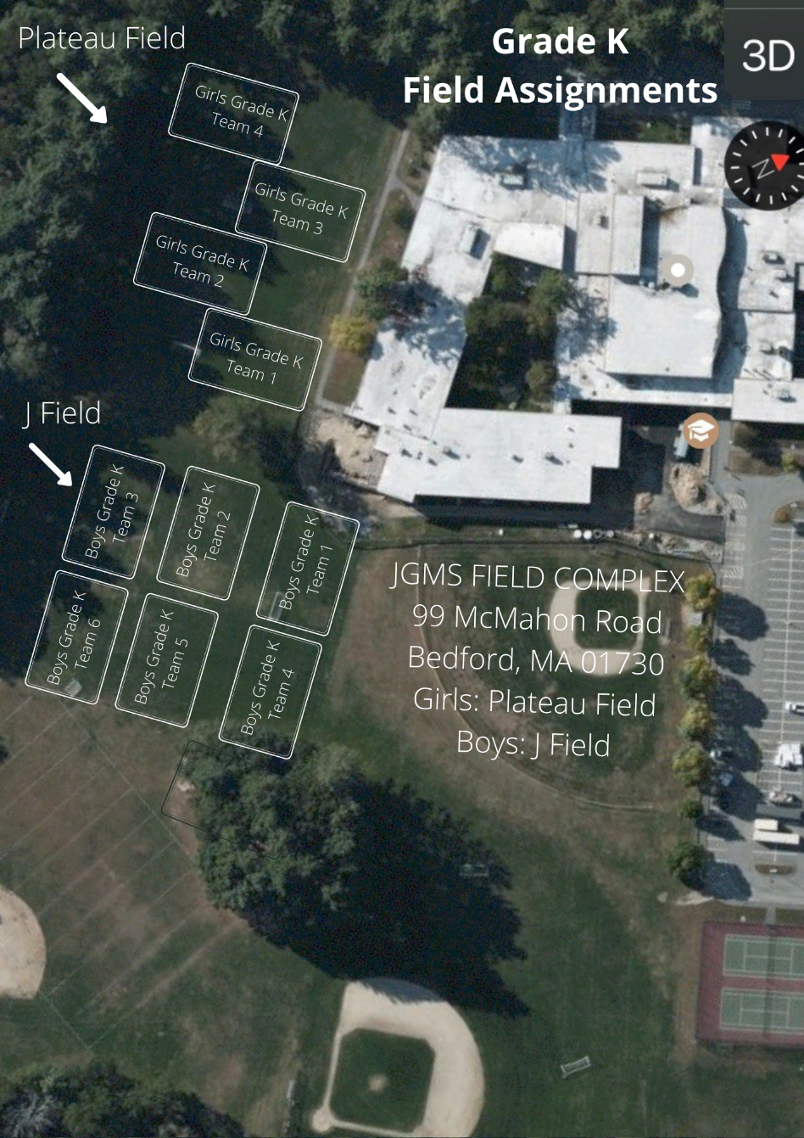
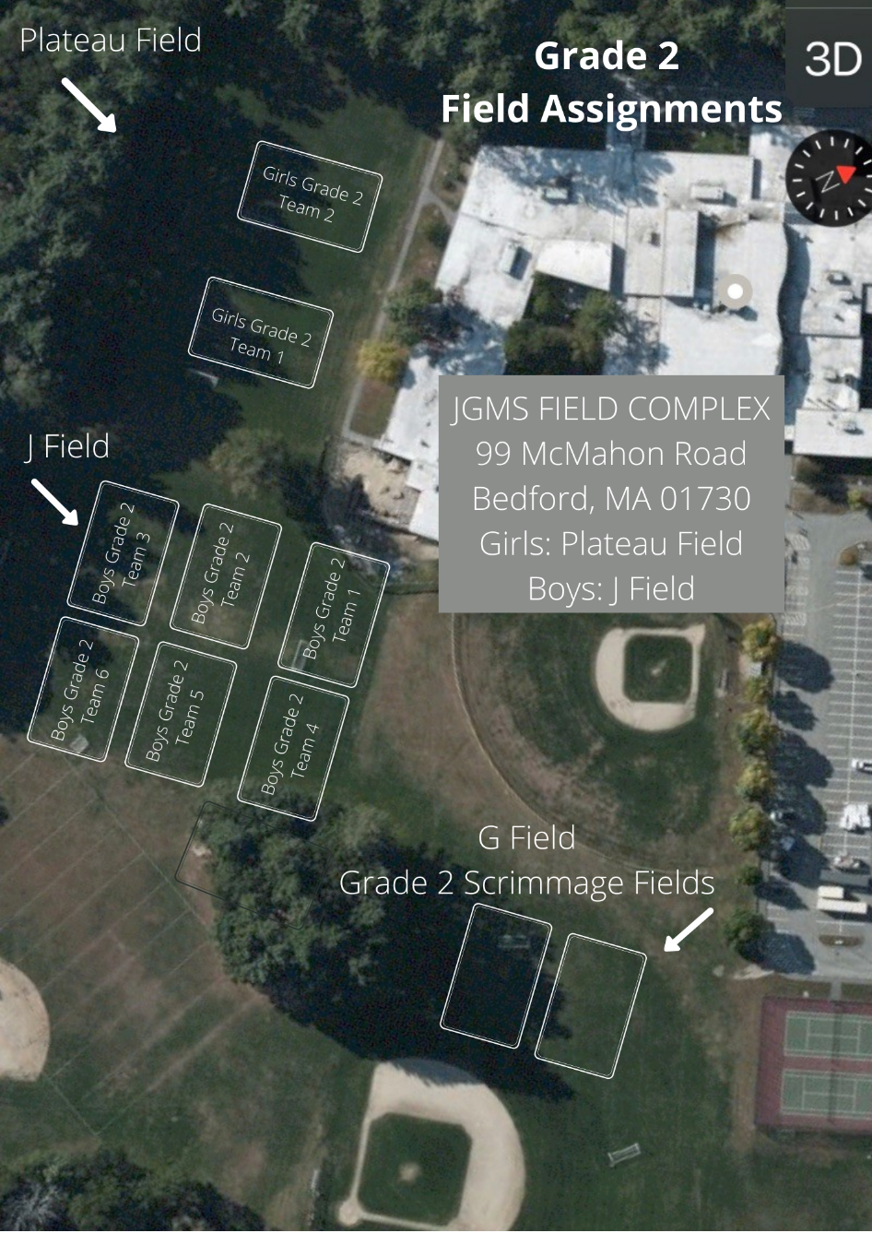
Field Setup

Slide 10
Its all about the Face Masks…
Facemasks must be worn by players at all times
Facemasks must be worn by coaches at all times
Facemasks must be worn by spectators at all times
Players may only use masks that wrap behind the ears – no gaiter mask!
The Coach/Assistant Coaches are responsible for making sure that all players/coaches/spectators are abiding by the facemask rules. If someone is in non-compliance the coach of that team should address the parent/spectator and if they do not comply the COVID Coordinator should contact the Recreation Department to report non-compliance.
Arguments and altercations regarding mask wear are to be avoided – just report it! Do not escalate the situation by applying repeated pressure.
Non compliance of facemask and distancing rules could result in suspension of field permits and program by the Town of Bedford.

Slide 11
Mask breaks
How do you drink water with a mask on?
YOU DON’T!
Kids will remove their mask to have water breaks.
Kids must maintain 6ft distance from each other when this happens.
How do kids get water break?
Each kid should have his/her own “Cone”-dom
Place cones at least 6 ft apart in a line on the side of the field
As kids come in, assign a kid a cone and have them put all their stuff next to that cone
As long as a kid puts a foot on the cone, mask can be removed to drink water
No one shall infringe on the sovereign boundary of a Cone-dom – (6ft boundary)
Trick: Place the cones where people and soccer balls are unlikely to cross

Slide 12
General Soccer Session
10 minutes before session start
Coaches arrive and setup Cone-dom and any drills
Players may not be dropped off early!
5 minutes before session start
Players begin to arrive
Coach/Covid Coordinator greets each player, verbally verifies no symptoms and assigns the kid to a coach-group and a Cone-dom
Session start
Start drills / practice portion of session (30 mins for K, 45 for 1st, 45-60 for 2nd)
~30 minute scrimmages
Start games / scrimmage
Session end time
Players leave field immediately – absolutely no “extra” shots/practice/mingling
Coaches only collect all equipment
10 minutes after session end time
Coaches need to vacate the field*
*While coaches should leave the field, coaches should never leave the facility before all kids have been picked up

Slide 13
Session Plans & Mentors
Session Plans will be provided by Proformance
Session plans are on the website www.bedfordyouthsoccer.org
Proformance Soccer will provide coaching mentors to explain drills at the beginning of each session.
Each team should send a coach to proformance’s explanation of the drills.
Typically 3 drills, ~8-10 minutes per with water breaks
Plans will be physical distance friendly
Please think about how to account for COVID, e.g.
For shooting drills, have a coach or parent stationed behind the net to nudge balls out with their feet so players aren’t having to dig around in the net
For drills that would normally have kids standing in line, space cones 6 ft apart to identify where they should wait
Please use the drills provided
Ensures all players focus on the same skills each week

Slide 14
Scrimmages
4v4 inter-team scrimmages
Half the players will stay at their “home” field with one coach, the other half will travel to another field with the 2nd coach
Critical to have 2 coaches each week to manage each team in the scrimmage – if a coach will miss a week, a parent will have to step in.
Don’t keep score
Balance teams to the best of your ability

Slide 15
Grade 2 Scrimmages

Slide 16
COVID-19 Tracing and procedures
When a parent/guardian brings a child to the first practice/scrimmage the child MUST bring a signed monitoring sheet required by the Town of Bedford. If a child does not have a sheet they will not be permitted to remain at soccer. Coaches will be provided extra monitoring sheets in case they forget.
By signing the monitoring sheet the parent is agreeing that they will keep their child home if they had answered yes to any of the monitoring questions.
Each team should have a COVID-19 Coordinator and must take attendance at all events and keep this record through the season.
If a child, coach or spectator tests positive the COVID-19 coordinator should contact Nikki or Amy at the Bedford Recreation Department immediately who will contact the Bedford Board of Health.

Slide 17
Agreement for Symptom Monitoring for the Town of Bedford
*must be turned in once at the start of the season.
Forms will be emailed to parents before the start of the season.

Slide 18
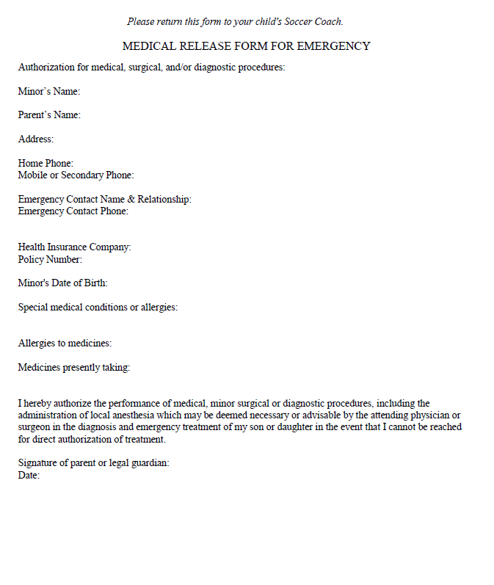
Medical Release Form
*Coaches keep forms in their team bag all season.
Forms will be emailed to parents before the start of the season.

Slide 19
CORI
Town of Bedford CORI form is required for all coaches/coordinators. CORI forms should be emailed to Nikki Taylor

Slide 20
Equipment/Equipment Distribution
Grade K-2:
Equipment pick up is Friday, April 9 from 4:00-6:00 PM at Springs Brook Park (181 Springs Road). Pleaes drive all the way down the road to the bathhouse for pick up.
12 Mudge Way will be closed the entire season. If you cannot make these pick up tiems please contact Nikki Taylor. If you need equipment replenished please contact Nikki Taylor at the Bedford Recreation Department.
Each coach will receive hand sanitizer and sanitizing wipes in their equipment bag.
Each player will receive a pinnie that they should be given at the first practice. Pinnies will be taken home by players each practice and brought back for their dedicated use for the season.
Shared equipment must be sanitized after each use.
Benches should not be used this season.

Slide 21
Additional Information
Communication with parents throughout the season is key.
Attitude: players follow the coaches example when it comes to attitude
Players may not wear jewelry
Weather cancellation:
By 7:00 AM (morning sessions)
By 11:00 AM (afternoon sessions)
If there is a weather cancellation it is the coaches responsibility to notify their players.

Slide 22
Coaching resources
Visit www.bedfordyouthsoccer.org for coaching resources
Nikki Taylor- Bedford Youth Soccer Liaison
Jason Rotella- Chair, Bedford Soccer Association
For weekend field closures/program cancellation due to weather please check our website at www.bedfordrecreation.org
Intramural Coordinators
Kevin Dickert
Jay Hadden

