Slide 1
Bedford Youth Soccer
Intramural
Coaches Meeting Spring 2022

Slide 2
Mission of Bedford Youth Soccer
Bedford Soccer's mission is to serve the children and achieve these goals:
1. All children can play. We provide opportunities for children of all skill levels to learn and
play the game.
2. Fun, learning, enjoyment. Having fun, learning and enjoying the game are always more
important than winning.
3. The game is the best teacher. Effective practice combines age-appropriate skill
development with time spent playing the game.
4. Sportsmanship and teamwork. Learning and demonstrating excellent sportsmanship and
teamwork are key parts of learning soccer.
5. Positive coaching. Coaching must always be positive, supporting children's enjoyment of
the game, strengthening children's self esteem and creating a positive environment.
6. Positive spectatorship. Parents and spectators play a crucial role in providing a positive
experience for the children. Positive spectators show respect for and appreciation of the
game, the coaches, and the players on all teams.

Slide 3
Bedford Youth Soccer Set Up
The Bedford Youth Soccer program differs from many towns in that it involves a collaboration of the town’s Recreation Department and Soccer Association, a volunteer group.
This collaboration has the potential to provide an especially strong program. The town’s Recreation philosophy is that Recreation programs are open to all Bedford Residents on an equal opportunity basis.
The soccer Association is responsible for coach recruitment, training, roster assignments, evaluations and many other things.
The Recreation Department Soccer Liaison is Nikki Taylor, who also serves as the Youth Program Coordinator.
The Intramural Program is for Grades K-2 with an option to continue in Grades 3-5.
Once a player is in Grade 3 they have the option to participate in the Travel Soccer Program.
The Soccer Association meets regularly. All association meetings are open to the public. Meeting dates and times are posted on the Bedford Youth Soccer Website.
The program relies on volunteers to make it possible.
You can read more about the Bedford Youth Soccer program here: https://bedfordyouthsoccer.org/

Slide 4
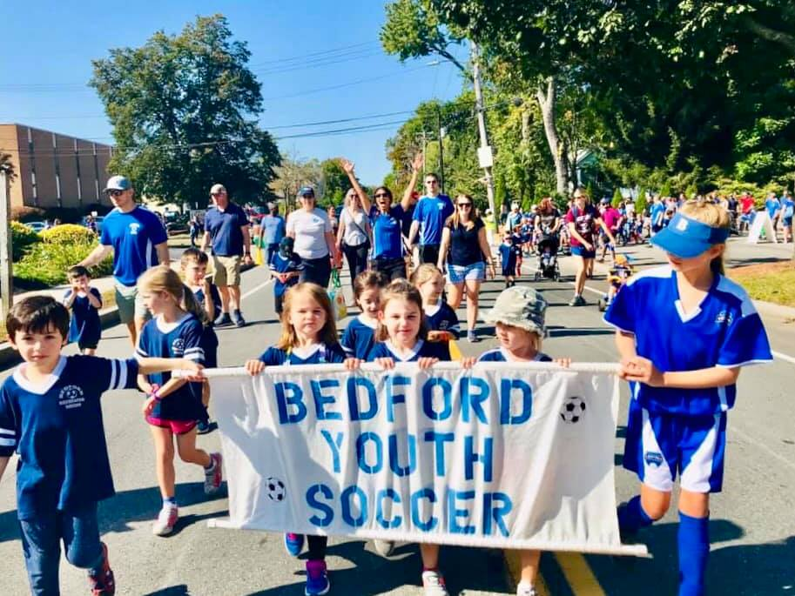
Bedford Youth
Soccer Website
www.bedfordyouthsoccer.org

Slide 5
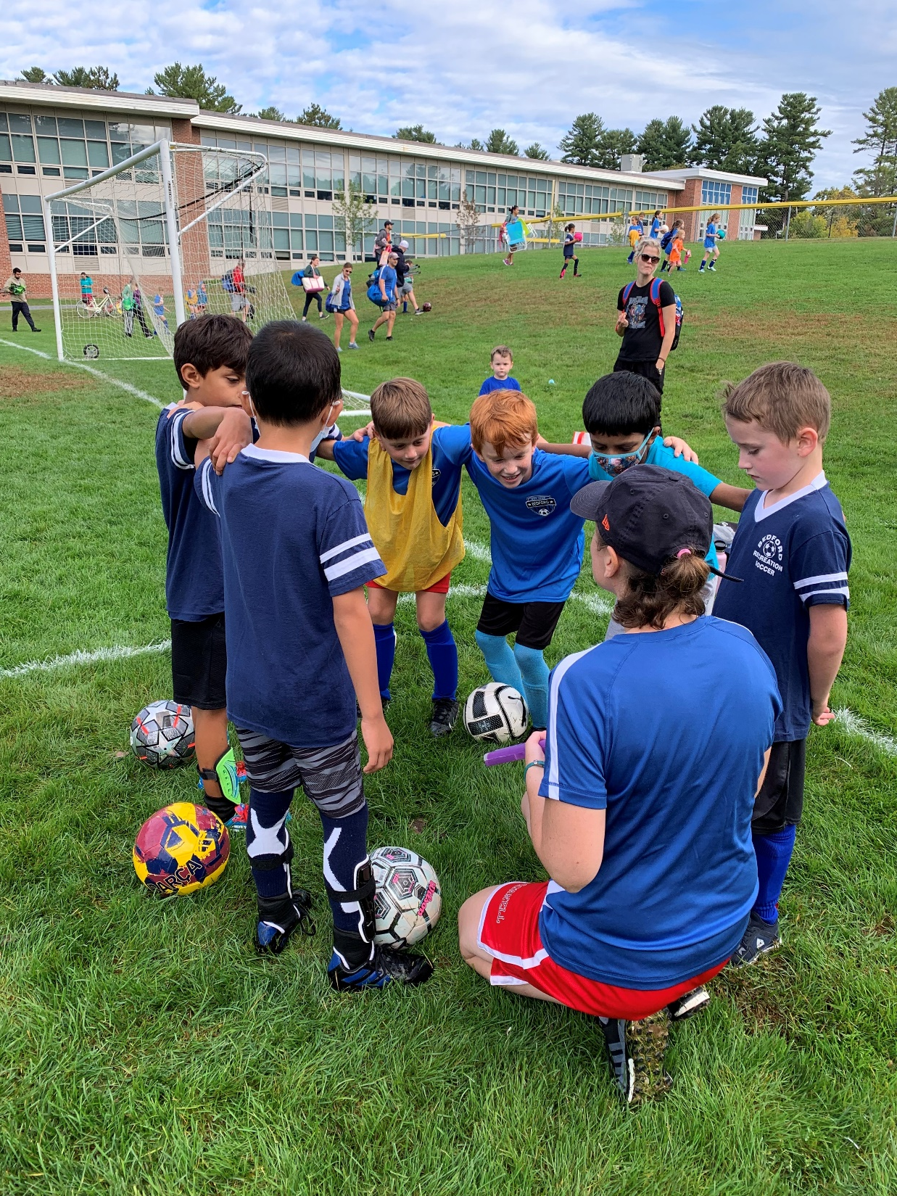
Age Group
Coordinators
PreK: Jess Pettitt
Boys K: Jay Hadden
Girls K: Rebecca Lecaroz
Boys 1: Katie Guerino
Girls 1: David Farmer
Girls 2: Annemarie Silver
Grade 3-5: John Holland
Intramural Coordinators:
Jay Hadden, Soccer Association Member
Bassim Ibrahim, Soccer Association Member
Soccer Association Chair:
Jason Rotella

Slide 6
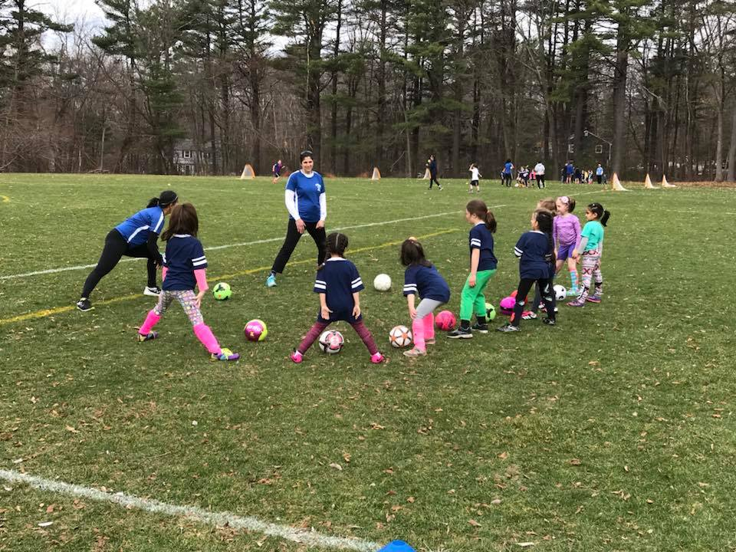
Program Dates, Times and Locations
Program Dates: 4/9-6/11 (no soccer on May 28)
Grade 3-5: 8:45-10:15 Am (South Road Field Complex)
PreK: 8:45-9:45 AM (John Glenn Middle School (H Field)
Grade 2: 8:45-10:15 AM (John Glenn Middle School; Boys: J Field/Girls: Plateau Field)
Grade K: 10:30-11:30 AM (John Glenn Middle School Boys: J Field/Girls: Plateau Field)
Grade 1: 11:45-1:00 PM (John Glenn Middle School; Boys: J Field/Girls: Plateau Field)

Slide 7
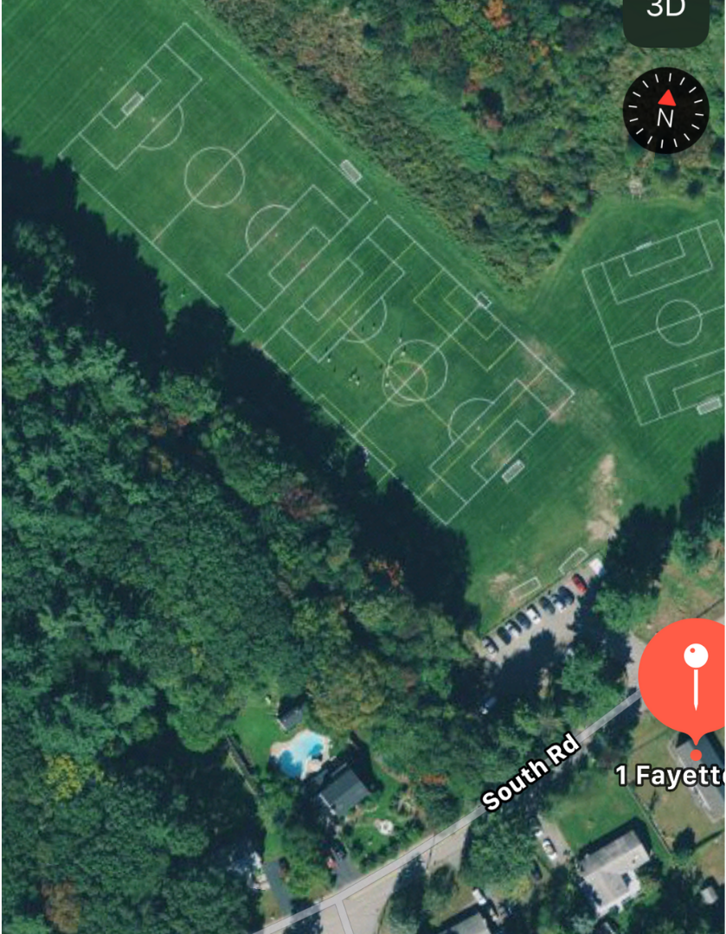
Field setup/Assignments
GRADE 3-5
SOUTH ROAD FIELDS
This field complex is dedicated to grade 3-5 Intramural. There will be some days when we will have one other game at this location.
When parking in the lot is not available, please park on Fayette Road, not South Road.

Slide 8
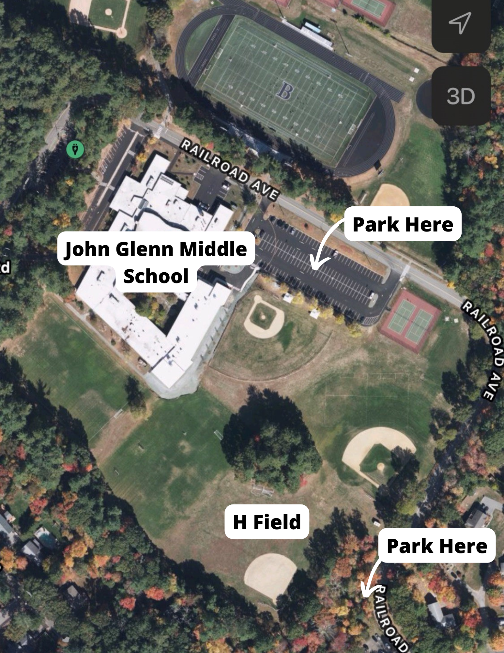
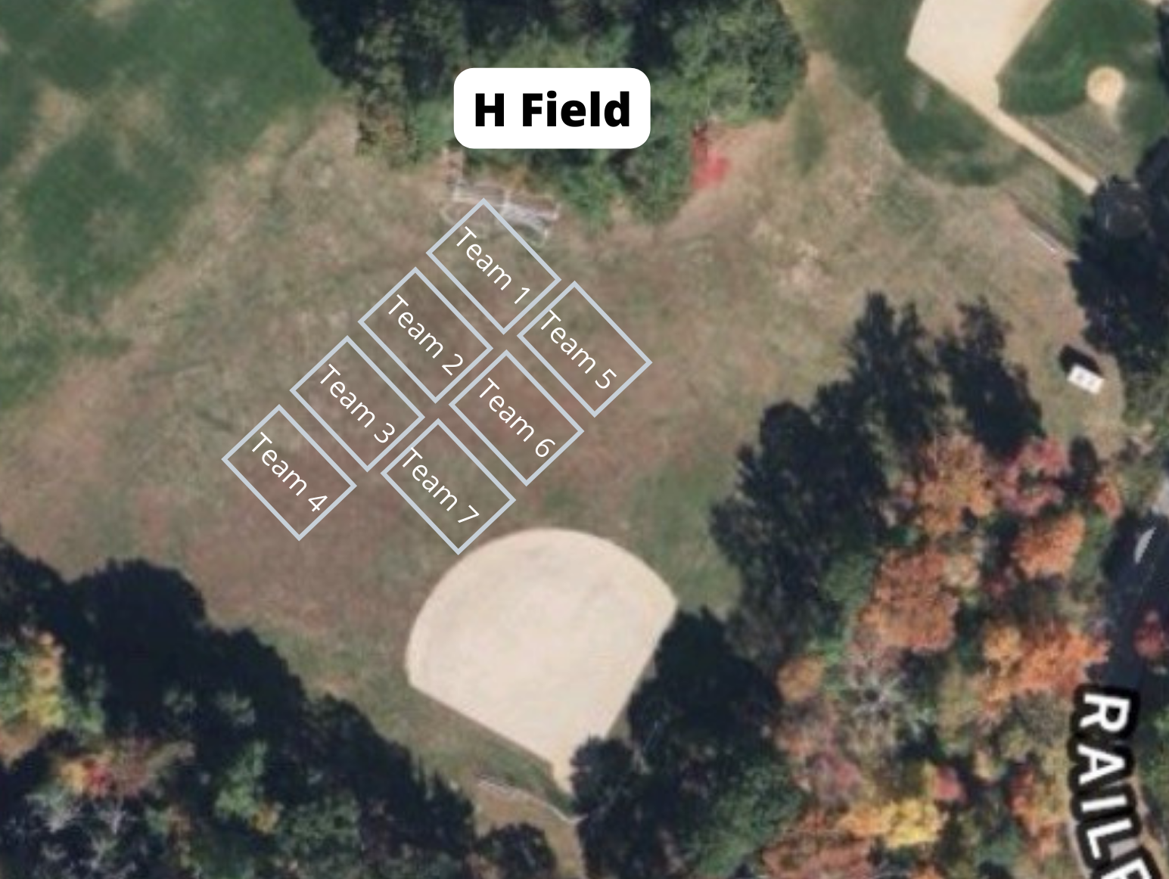
Field setup/Assignments
PreK
H Field
Due to the large interest, we have moved the PreK age group to H Field. H Field is located at the John Glenn Middle School (99 McMahon Road).
Grade 2 will be taking place on the other fields at the same time.

Slide 9
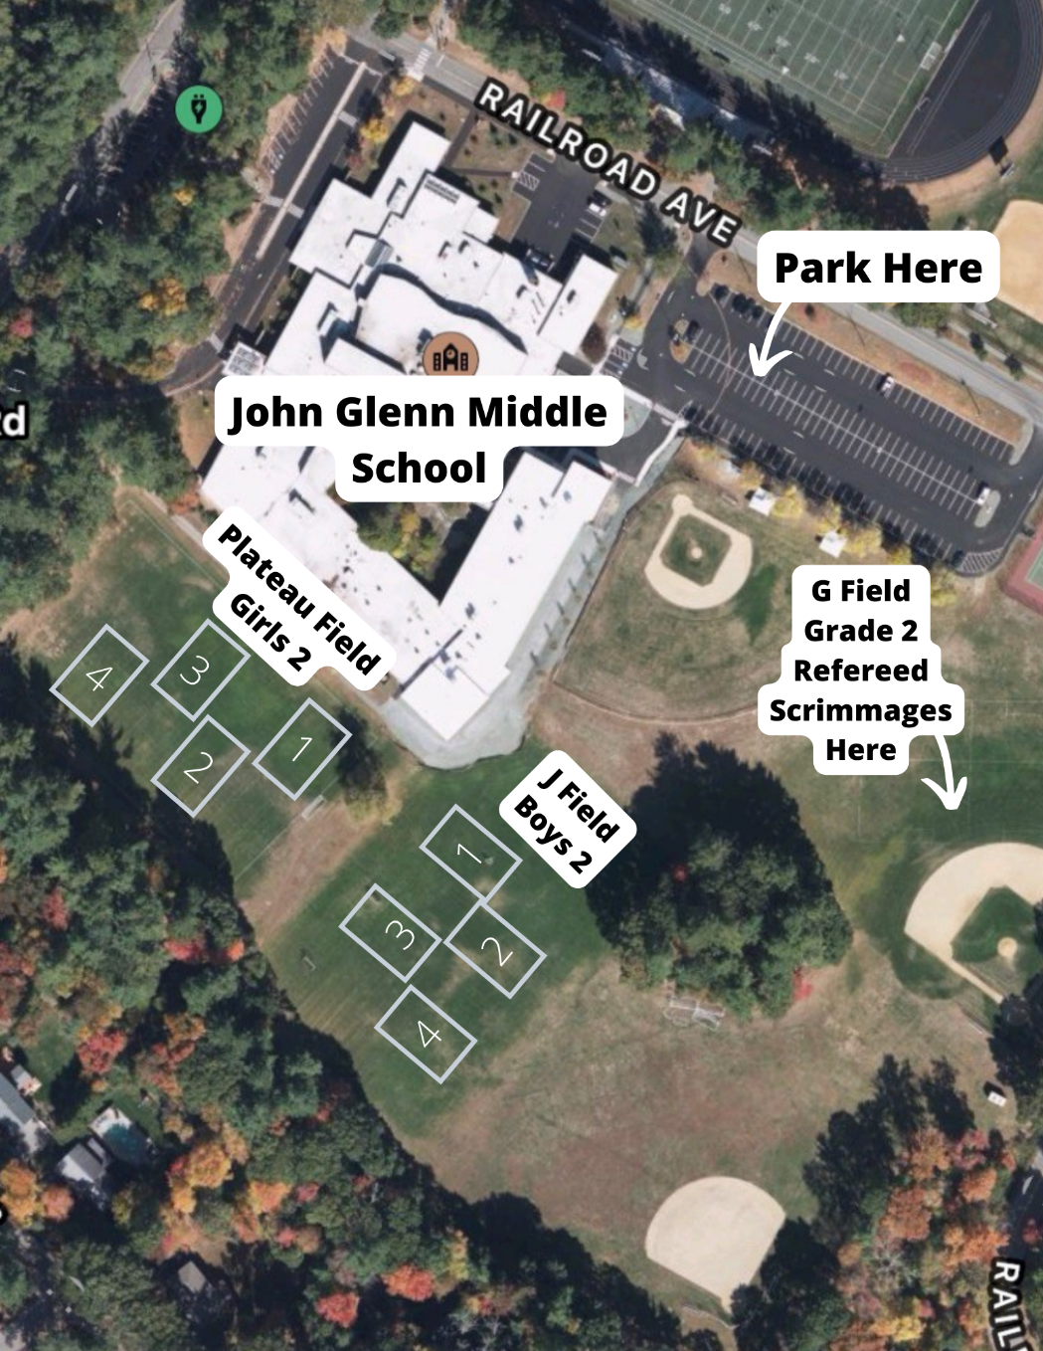
Field setup/Assignments
Grade 2
Girls: Plateau/Boys: J Field
Scrimmages will take place on G Field. G Field is the outfield of the large baseball field at the Middle School.

Slide 10
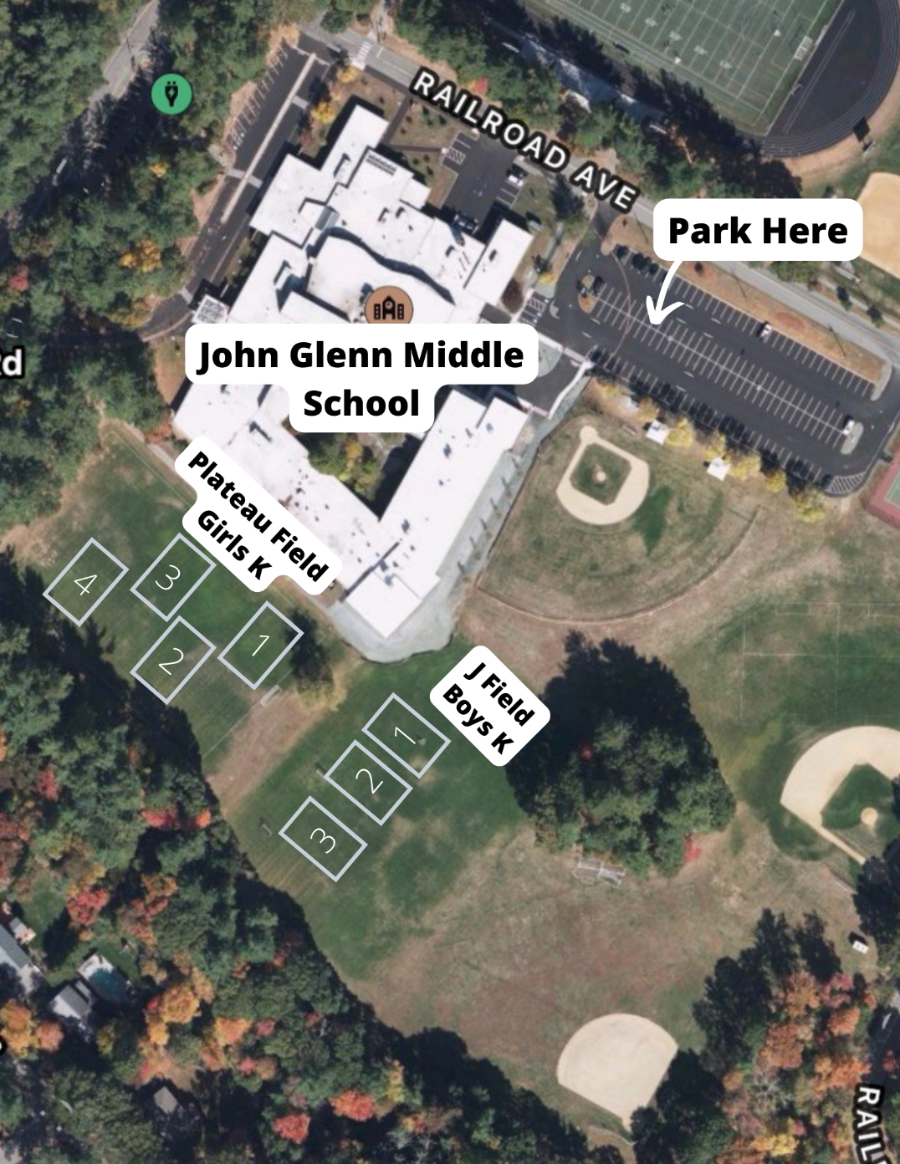
Field setup/Assignments
Grade K
Girls: Plateau/Boys: J Field

Slide 11
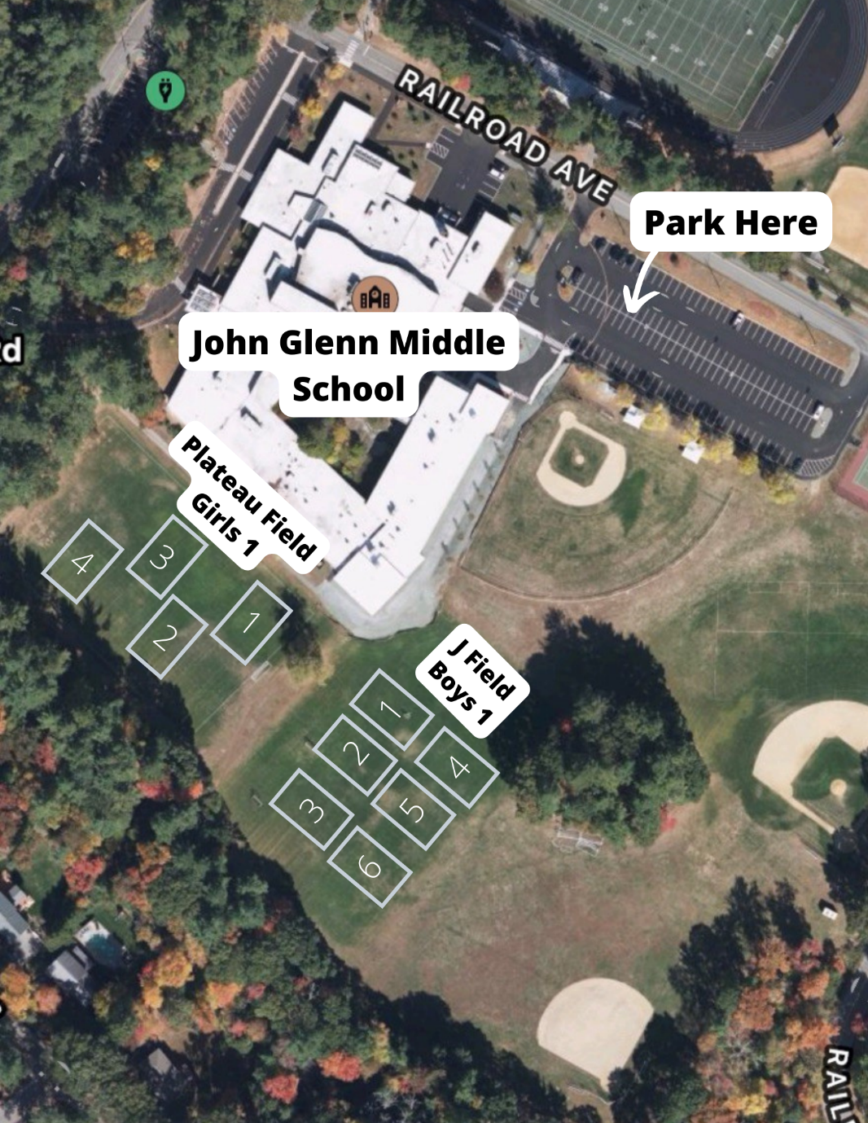
Field setup/Assignments
Grade 1
Girls: Plateau/Boys: J Field

Slide 12
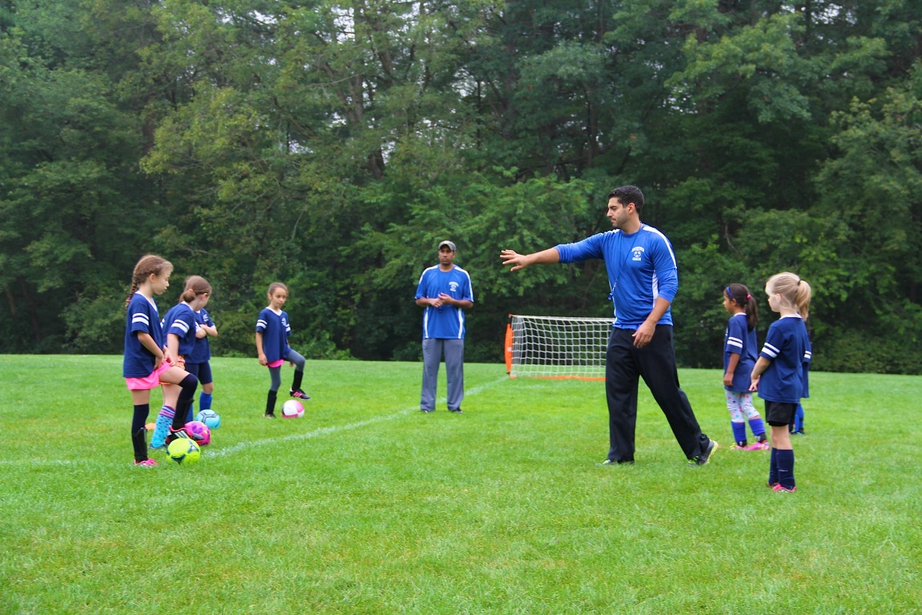
COVID-19 Impacts
Currently, there are no state mandated COVID-19 restrictions for Soccer.
Players are not required to wear masks but they may choose to.
Additional cleaning supplies and hand sanitizer will be given to each team with additional supplies available upon request.
We ask that coaches sanitize all shared equipment (balls, cones, etc.) often.

Slide 13
Proformance Mentors
Since the Spring 2014 season, the Bedford Youth Soccer K-2 intramural has been using a coaching mentor program.
The mentor program works by enlisting the help of a professional coach to help the Bedford intramural coaches with their practices. Each week a practice plan will be supplied in advance of the Saturday practice, and each week, right before the practice session, the mentor coach will review the practice plan with the intramural coaches so everyone is familiar with the plan and knows how best to execute it. Then during the practice sessions, the mentor coach rotates through the groups to help coaches with the practices.
This mentor coaching program is being done in conjunction with PROformance Soccer Academy, who have successfully run similar programs, with great reviews, in several other communities.
PreK Impact: PreK will have a dedicated mentor. Grade 2 will have one dedicated mentor this spring. Those two age groups will be meeting at the same time.

Slide 14
General Soccer Session
10 minutes before session start
Coaches arrive and setup Cone-dom and any drills
Players may not be dropped off early!
5 minutes before session start
Players begin to arrive
Coach/Covid Coordinator greets each player, verbally verifies no symptoms and assigns the kid to a coach-group and a Cone-dom
Session start
Start drills / practice portion of session (30 mins for K, 45 for 1st, 45-60 for 2nd)
~30 minute scrimmages (PreK Scrimmages about 15 minutes—First few weeks will be tough!)
Start games / scrimmage
Session end time
Players leave field immediately – absolutely no “extra” shots/practice/mingling—Keeps things moving between age groups.
Coaches only collect all equipment
10 minutes after session end time
Coaches need to vacate the field*
*While coaches should leave the field, coaches should never leave the facility before all kids have been picked up

Slide 15
Session plans & Mentors
Session Plans will be provided by Proformance
Session plans are on the website www.bedfordyouthsoccer.org
Proformance Soccer will provide coaching mentors to explain drills at the beginning of each session.
Each team should send a coach to proformance’s explanation of the drills.
Typically 3 drills, ~8-10 minutes per with water breaks
Plans will be physical distance friendly
Please use the drills provided
Ensures all players focus on the same skills each week
PreK and Kindergarten—Will use same drills
Grade 1, 2 & 3-5—Will use same drills

Slide 16
Scrimmages
4v4 inter-team scrimmages
Half the players will stay at their “home” field with one coach, the other half will travel to another field with the 2nd coach
Critical to have 2 coaches each week to manage each team in the scrimmage – if a coach will miss a week, a parent will have to step in.
Don’t keep score
Balance teams to the best of your ability
Will take a few weeks to know true ability. Please make sure teams are balanced in you are not always playing the strongest kids against the strongest kids. There should be an equal amount of strength on each “team.”

Slide 17
Pre K
Due to a large demand, Bedford Youth Soccer is now offering a PreK Intramural Section.
This hour long session will meet on H Field.
A mentor will be assigned to the PreK Group and will move from group to group each week.
PreK will utilize the same practice plans as Grade K.
Teams were forms to be as balanced as possible in terms of Boys/Girls and 4/5 year olds.
Feedback is welcome as this is the first time offering this age group.
Please send feedback to me or Jess (AGC) at anytime throughout the season.

Slide 18
Grade 2 Scrimmages
Grade 2 will participate in scrimmages that are officiate by referees.
These scrimmages will begin the second week of soccer (September 25).
Your AGC will put together a scrimmage schedule.
Scrimmages will take place on the outfield of G Field (there are lines and goals there).
We treat these scrimmages as actual games and try to use them as an opportunity to teach players more about playing in an actual game.
Players should not wear jewelry.

Slide 19
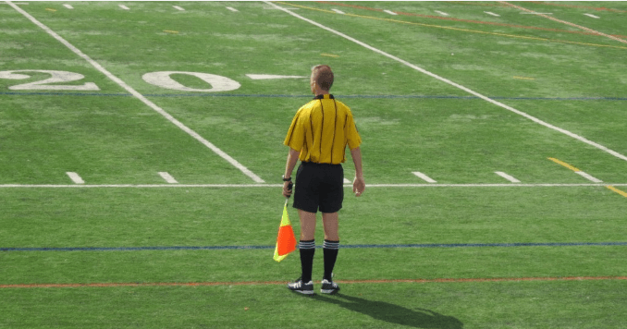
Zero tolerance policy For Grade 2
ZERO TOLERANCE POLICY:
All individuals responsible for a team and all spectators shall support the referee. Failure to do so will undermine the referee’s authority and has the potential of creating a hostile environment for the players, the referee, and all the other participants and spectators.
Consequently, BAYS has adopted and modified the following rules:
No one, except the players, is to speak to the referee during or after the game. Exceptions: Coaches may ask questions before the game, call for substitutions and point out emergencies during the game, or respond to the referee if addressed.
Absolutely no disputing calls, during or after the game, no remarks to the referee to watch certain players or attend to rough play. NO YELLING at the referee, EVER, and no criticism, sarcasm, harassment, intimidation, or feedback of any kind during or after the game.
Violators may be ejected and are subject to disciplinary action by the BAYS Sportsmanship Review Committee.
If coaches or spectators have questions regarding particular calls, rules, or a referee, or wish to give feedback regarding a referee, please contact the town soccer club referee’s coordinator for the game in question, or contact the BAYS Referees Representative at http://www.bays.org

Slide 20
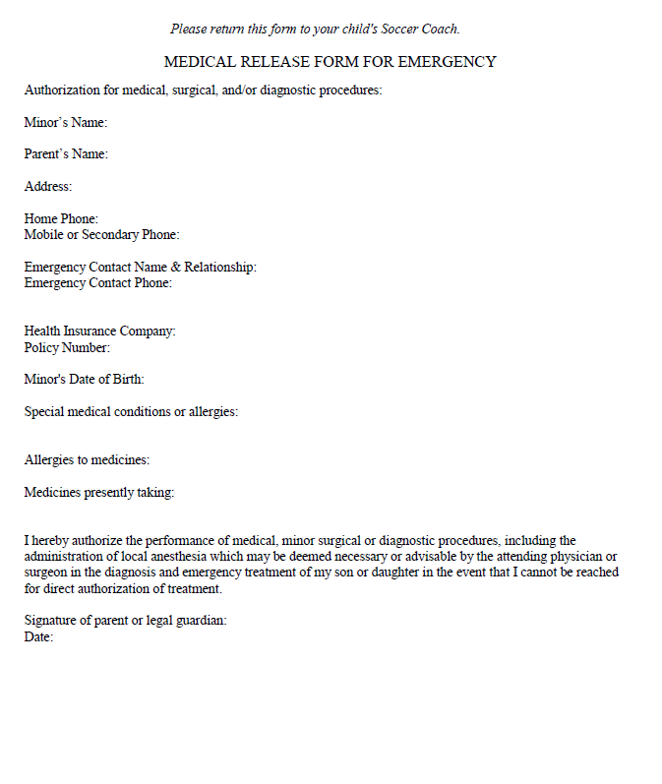
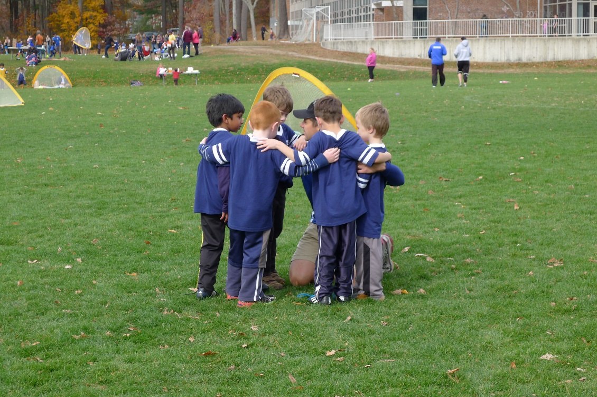
Medical form
*Coaches keep forms in their team bag all season.
Forms will be emailed to parents before the start of the season.
This form will also include a zero tolerance pledge.

Slide 21
cori process
All coaches must have a current CORI on file.
If you have been asked to fill out a CORI please do so as soon as possible by using this link:
https://bedfordma.seamlessdocs.com/f/CORI
Please contact Nikki with any questions.

Slide 22
Weather Cancellations
If Intramural Soccer is cancelled due to weather you will receive an email in the morning.
We ask that you please send an additional email to your teams to let them know that the session is cancelled.
Sessions cancelled due to weather are not made up at the end of the season.
When making the decision to cancel, the Soccer Association is looking at the weather AND field conditions. If the field conditions are unsafe or using them would cause damage we will cancel the session.

Slide 23
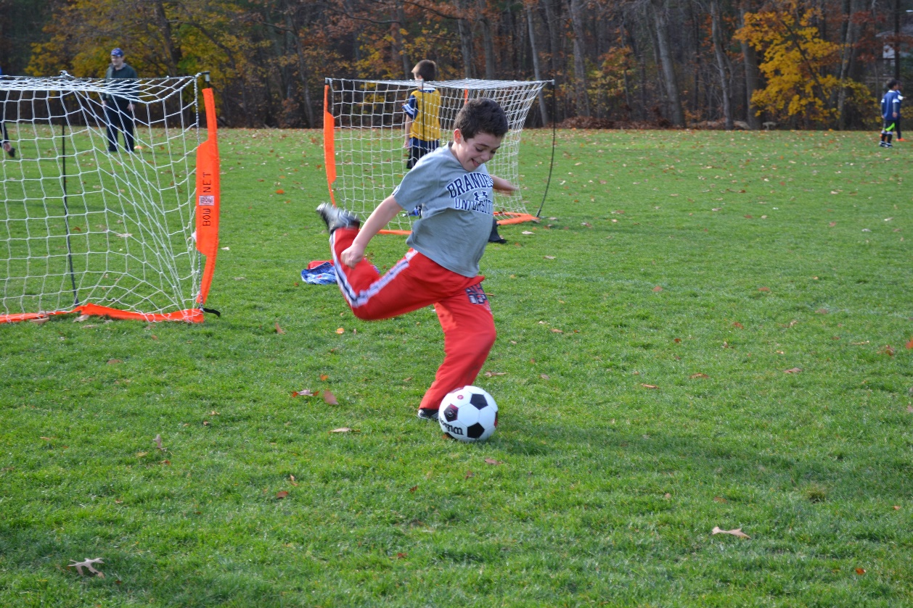
Equipment/Equipment Distribution
Equipment pick up is Thursday, April 7 from 5:00-6:00 PM at the Bedford Recreation Department (12 Mudge Way). Equipment pick up will be INSIDE. Please enter through the double green doors and come to the second floor.
Coaches who would like a free coach t-shirt should email me prior to this date with their shirt size. Shirts will be included in the team bag and handed out on the first day of soccer.
If a player ordered a uniform it will be in your team bag to be handed out on the first day of soccer. If anyone says they ordered one but did not receive on please have them reach out to Nikki.

Slide 24
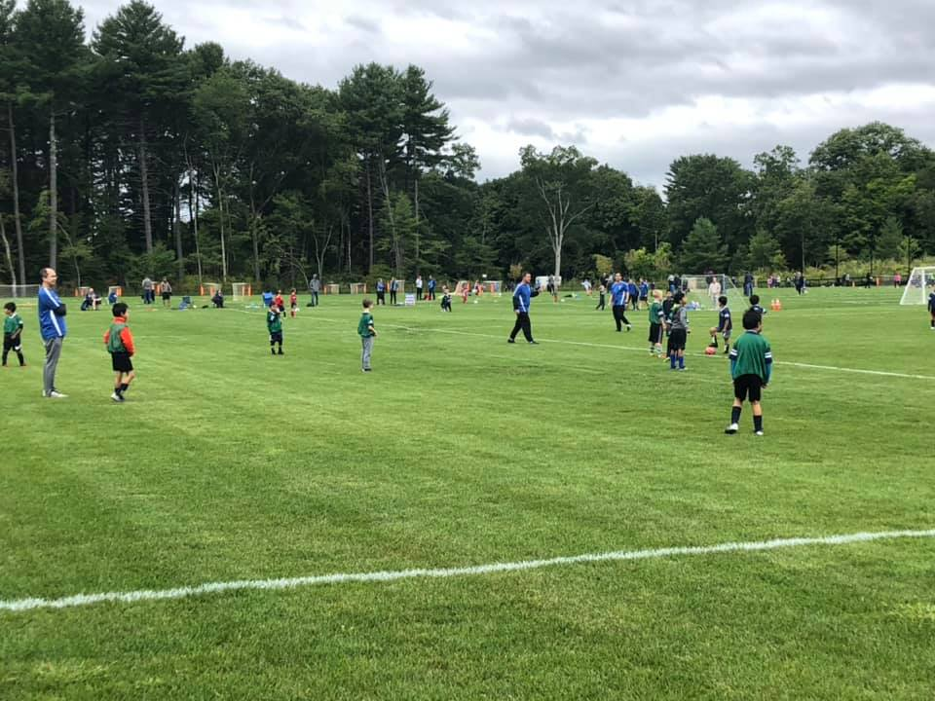
Coaching resources
Visit www.bedfordyouthsoccer.org for coaching resources
Nikki Taylor- Bedford Youth Soccer Liaison
Jason Rotella- Chair, Bedford Soccer Association
Practice Plans: https://bedfordyouthsoccer.org/practice-plans/
For weekend field closures/program cancellation due to weather please check our website at www.bedfordyouthsoccer.org
Intramural Coordinators:
Intramural Coordinator
Jay Hadden
Bassim Ibrahim

