Slide 1
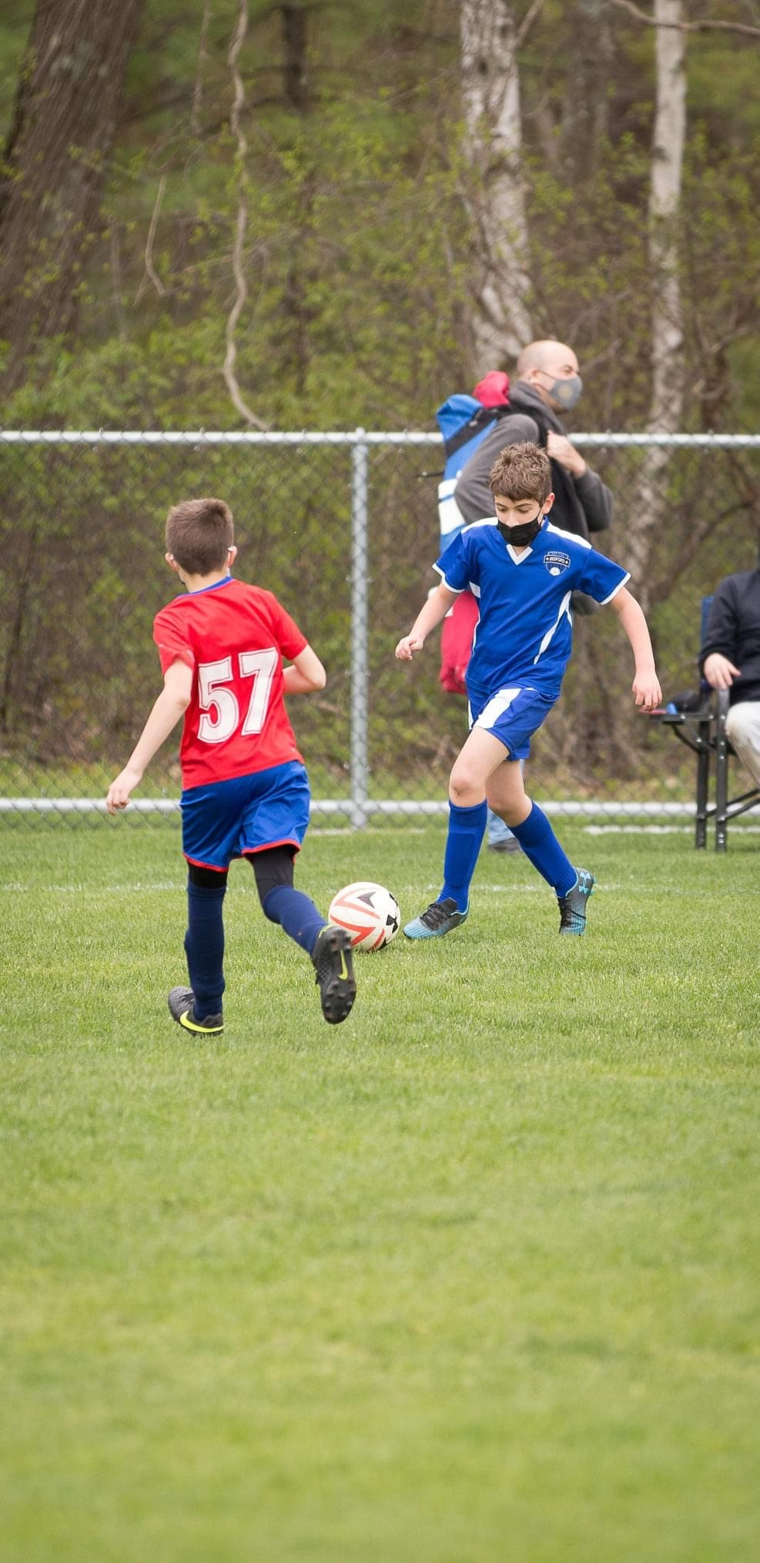

Bedford Youth Soccer
Travel Coaches Meeting Spring 2022
3rd-8th Grade

Slide 2
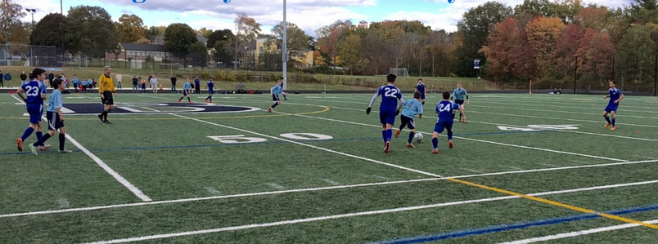
Agenda
Mission of Bedford Youth Soccer
Important Websites
Referees
Zero Tolerance Policy
Games/Schedules
Practice Format
Medical Forms
Adult Registration and CORI Process
Fields
Travel Field Assignments
Coaching Resources

Slide 3
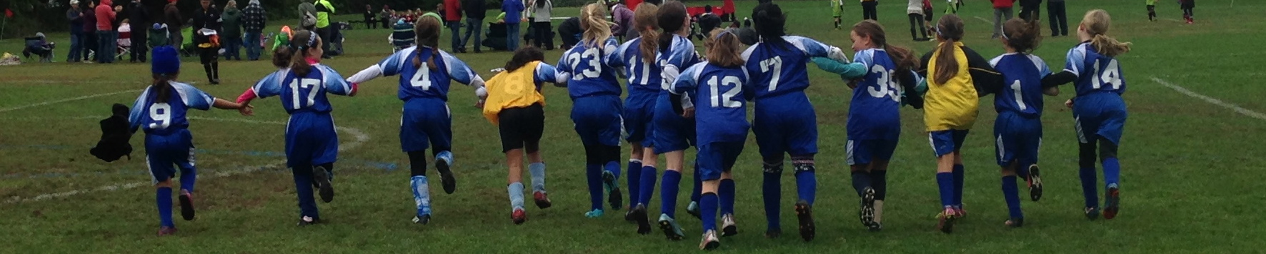

Mission of Bedford Youth Soccer
Bedford Soccer's mission is to serve the children and achieve these goals:
1. All children can play. We provide opportunities for children of all skill levels to learn and
play the game.
2. Fun, learning, enjoyment. Having fun, learning and enjoying the game are always more
important than winning.
3. The game is the best teacher. Effective practice combines age-appropriate skill
development with time spent playing the game.
4. Sportsmanship and teamwork. Learning and demonstrating excellent sportsmanship and
teamwork are key parts of learning soccer.
5. Positive coaching. Coaching must always be positive, supporting children's enjoyment of
the game, strengthening children's self esteem and creating a positive environment.
6. Positive spectatorship. Parents and spectators play a crucial role in providing a positive
experience for the children. Positive spectators show respect for and appreciation of the
game, the coaches, and the players on all teams.

Slide 4
COVID-19 Impacts
Currently, there are no state mandated COVID-19 restrictions for Soccer.
Players, spectators and coaches may want to wear masks but are not required to.
Additional cleaning supplies and hand sanitizer will be given to each team with additional supplies available upon request.
We ask that coaches sanitize all shared equipment (balls, cones, etc.) often.

Slide 5
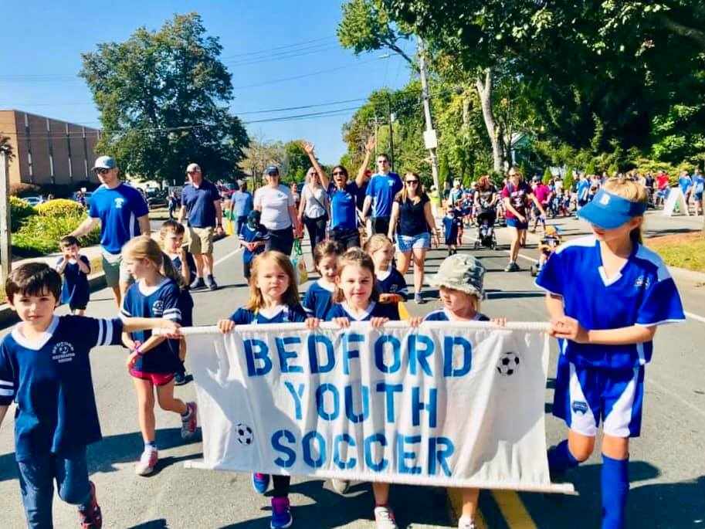
Current Rule book
Bedford Youth
Soccer Website
www.bedfordyouthsoccer.org
BAYS Website
www.bays.org
https://bays.org/book/playing-rules-and-regulations-bays-soccer-competition

Slide 6
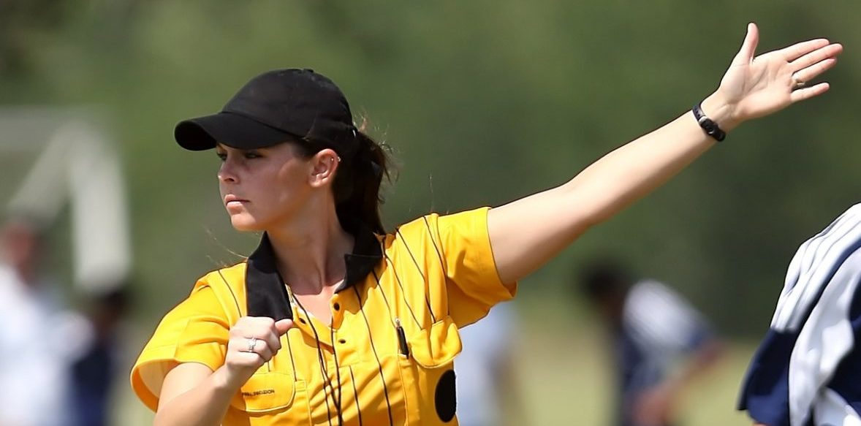
Referees
The referee coordinator is Bob Goodman
  Bob is responsible for the training, coordination and scheduling of referees.
  If there is an issue concerning a referee you should be reaching out to Bob.
  How to confirm your referee?
    For home games, Head Coaches should be reaching out to their scheduled referee a few days before the game to confirm that they are aware of the game. If an issue arises that will give us time to trouble shoot.
Respect the referees -- Zero Tolerance (see next slide)
Support the younger, newer referees -- especially if any coaches or spectators are heckling!
Contact Bob Goodman with any referee feedback, positive and negative.
Rainouts and rescheduled games -- coach responsibility to contact referees early and see if original referee can work the rescheduled game. They need to contact you first to confirm a field. Keep me informed of rescheduled games and if I need to find replacement referees.
Read the Laws of the Game and the BAYS-specific rules.
Game Day Reminders from Bob Goodman:
  come with INFLATED game balls,
  subs from half line only (not from bench) and player needs to be waiting at the half line when ball goes out of play,
  Come with two printed rosters, corner flags, make sure goals are anchored and nets are without holes and attached to the goal frame, etc.

Slide 7
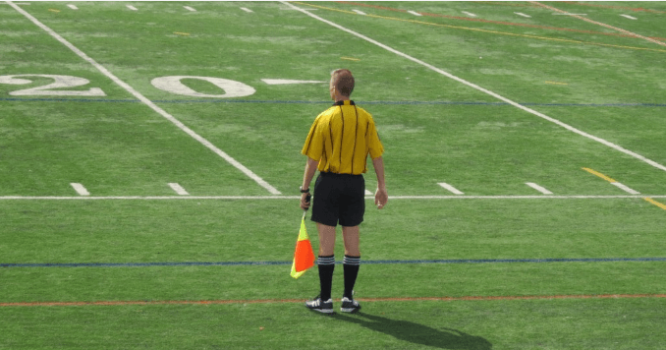
Zero tolerance policy
ZERO TOLERANCE POLICY:
All individuals responsible for a team and all spectators shall support the referee. Failure to do so will undermine the referee’s authority and has the potential of creating a hostile environment for the players, the referee, and all the other participants and spectators.
Consequently, BAYS has adopted and modified the following rules:
No one, except the players, is to speak to the referee during or after the game. Exceptions: Coaches may ask questions before the game, call for substitutions and point out emergencies during the game, or respond to the referee if addressed.
Absolutely no disputing calls, during or after the game, no remarks to the referee to watch certain players or attend to rough play. NO YELLING at the referee, EVER, and no criticism, sarcasm, harassment, intimidation, or feedback of any kind during or after the game.
Violators may be ejected and are subject to disciplinary action by the BAYS Sportsmanship Review Committee.
If coaches or spectators have questions regarding particular calls, rules, or a referee, or wish to give feedback regarding a referee, please contact the town soccer club referee’s coordinator for the game in question, or contact the BAYS Referees Representative at http://www.bays.org

Slide 8
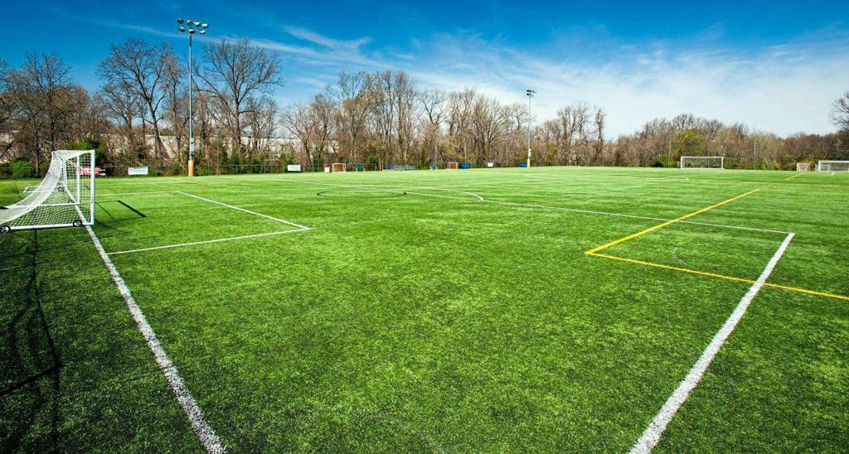
Games
Games begin on Saturday, April 9.
We are unapologetic about maintaining equal playing time in all positions, even goal. We are a town program, not a club program. We can play to win without sacrificing those principals
Fun: the top reason that kids stop playing is lack of fun
Match Day Check List
  Referee
  Corner Flags
  Goals
  Inspect the field conditions
  Rosters-2 official copies for each game. Official BAYS roster (different from roster announcement) will be emailed to you. Print a bunch of copies for your bag.
  Reporting results: Report your results to your BAYS section leader after your game. This is important so records are accurate, especially for misplaced teams.
  Misplaced teams: If you are overwhelmed or overwhelming there is a possibility of moving after week 5. We will monitor. Talk to your AGC.
  No heading for anyone except grades 7/8
  BAYS guidelines for goal differential
    Max goal differential of 5 there is a good presentation on the BAYS website on how to manage. If you are not managing this we will hear about it.

Slide 9
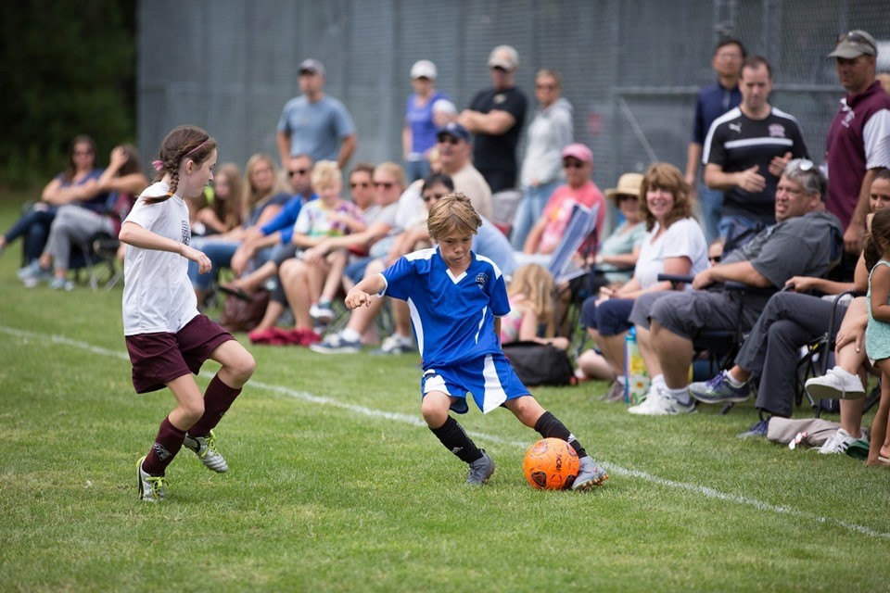
How do I access my team’s schedule?
You can access your schedule this way:
Or this way…
Step 1: www.bays.org
Step 2: Current Season
Step 3: Schedule
Step 4: Chose the following for your team:
  Season
  Gender
  Grade
  Division
  Home Section
  Week
Step 1: www.bays.org
Step 2: Current Season
Step 3: Teams/Games/Standings by town
Step 4: Chose Bedford Youth Soccer
Step 5: Chose your team
You can sync your game schedule to your calendar.

Slide 10
Team Name
Please forward me your team’s name as soon as possible so it can be included on your official BAYS roster.

Slide 11

Official
BAYS Roster
Your team received a “roster announcement” from the Recreation Department. This is NOT your official BAYS Roster. It is just used for informational purposes.
Official BAYS Rosters will be generated by the Bedford Registrar (Nikki Taylor) and will be submitted to the league for approval.
Once the roster is approved by the league it will be emailed to you from Nikki. This roster contains all players and properly-credentialed coaches.
Coaches are required to bring two PAPER copies of this roster to each game. One copy will go to your opponent and one copy will go to your opponent.
Your team will not be permitted to play without copies of this roster. Additionally, coaches not listed on the roster are not permitted to be on the sideline.
Only 4 coaches are eligible to be listed on each roster and only 3 coaches are allowed on the sideline of each game.

Slide 12
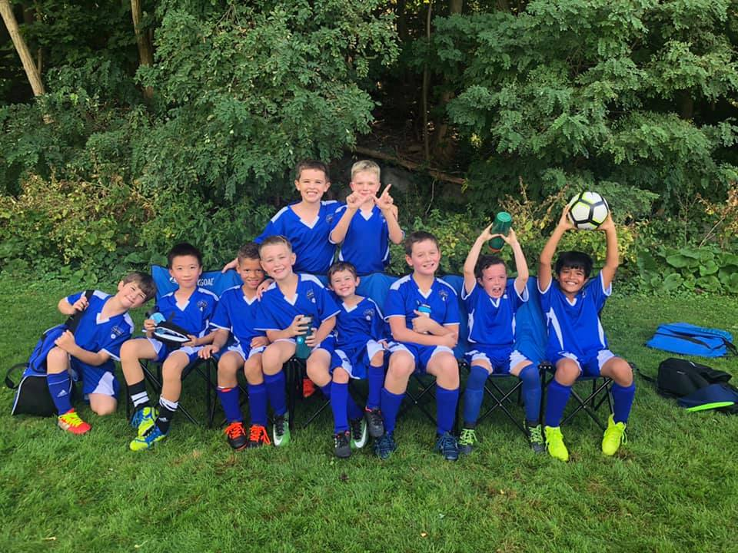
games
Please Do:
  Contact your opposing team’s coach by Wednesday before game
  Verify your referee is coming to the game by Wednesday before the game
  Verify your team’s availability for games over Bedford Day and Indigenous People’s Day Weekend
    Pre-pone games if you will not have enough players
Communication with parents throughout the season is key.
Attitude: players follow the coaches example when it comes to attitude
Take care of the fields. Move the goals out of the goal mouths for practices.
Players may not wear jewelry
Weather cancellation:
  By 7:00 AM (morning sessions)
  By 11:00 AM (afternoon sessions)
  If there is a weather cancellation it is the coaches responsibility to notify their players.

Slide 13
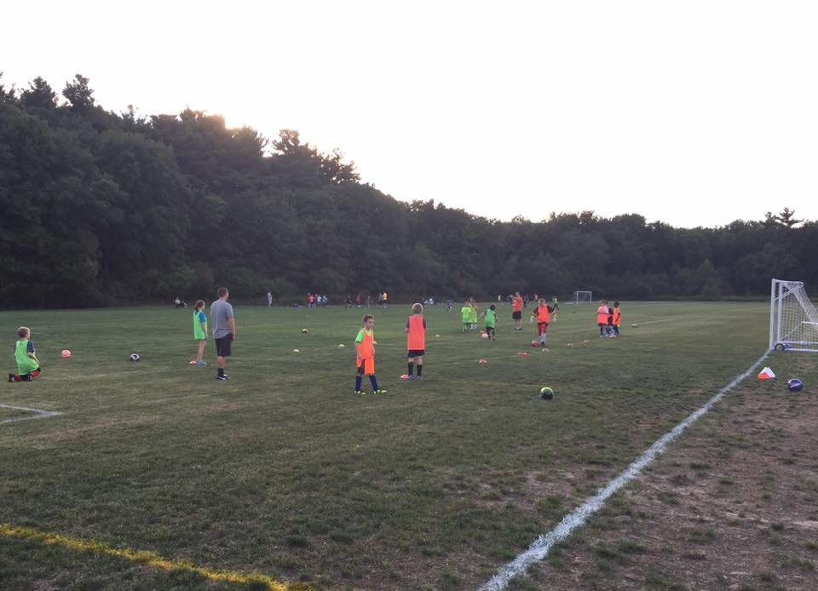
General Soccer Practice format
10 minutes before session start
  Coaches arrive and setup kid belongings area and any drills
  Players may not be dropped off early!
5 minutes before session start
  Players begin to arrive
  Coach greets each player, verbally verifies no symptoms and assigns the kid to an area for that belongings
Session start
  Start drills / practice portion of session
40-60 minutes after session start
  Start games / scrimmage
Session end time
  Players leave field immediately – absolutely no “extra” shots/practice/mingling
  Coaches only collect all equipment
10 minutes after session end time
  Coaches leave field

Slide 14
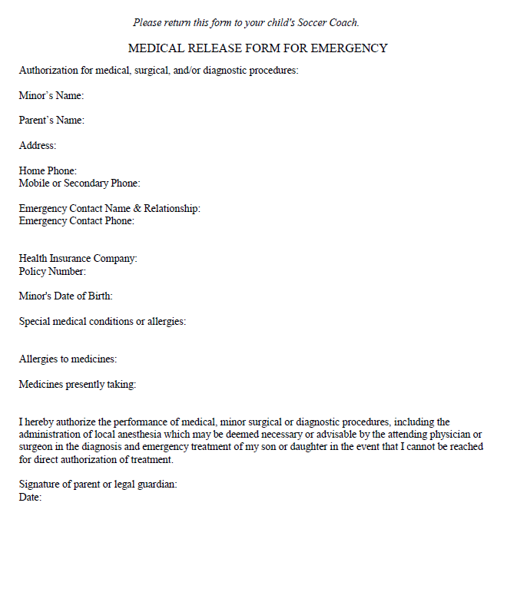
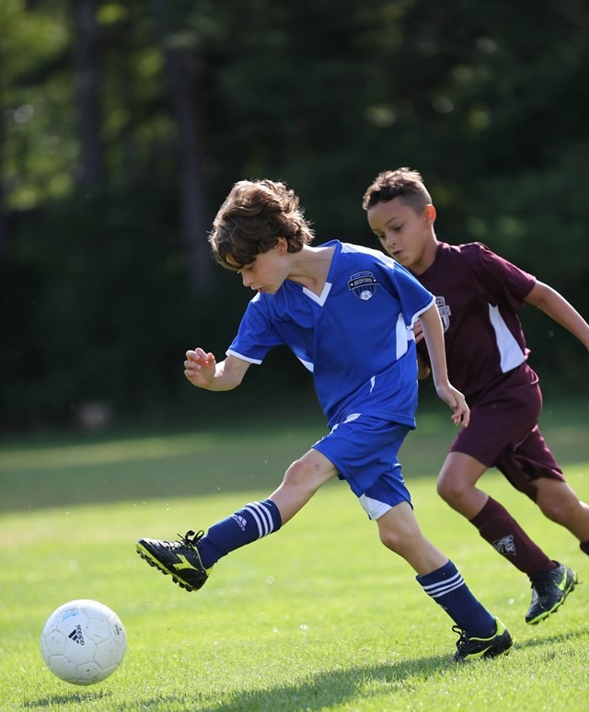
Medical form
*Coaches keep forms in their team bag all season.
Forms will be emailed to parents before the start of the season. Extra forms will be in your team bag as well.
This form will also include a zero tolerance pledge.

Slide 15
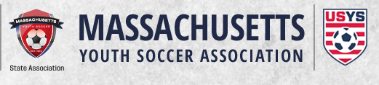
Adult registration/cori process
MYSA Cori process has been emailed to all coaches.
Coaches who have not completed all requirements will not be able to attend any practices until they are cleared by Nikki.
We will not be able to add your team roster until you have completed the process.
CREDENTIALS- If you have completed all requirements your coach credential will be in your team bag by equipment pick up. If you still have things to complete we will need to schedule a time for you to pick it up once you are completed.
Please contact Nikki with any questions.

Slide 16
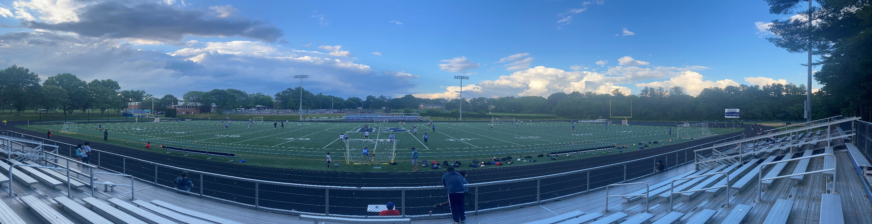
fields
Protect our fields
  Move goals for practices to avoid wear and tear to the goal mouths
  Moving the goals out of the goal mouths will also help the Public Works department mow inside of the goals
  Make sure the goals are anchored
  Avoid wet areas, damage to the field takes longer to fix than it does to create
  Report any hazards, unanchored goals, broken equipment, or any issues to the fields to Nikki Taylor as soon as you notice it. Do not fix equipment or field conditions on your own. Nikki’s contact information is 781-275-1392;

Slide 17
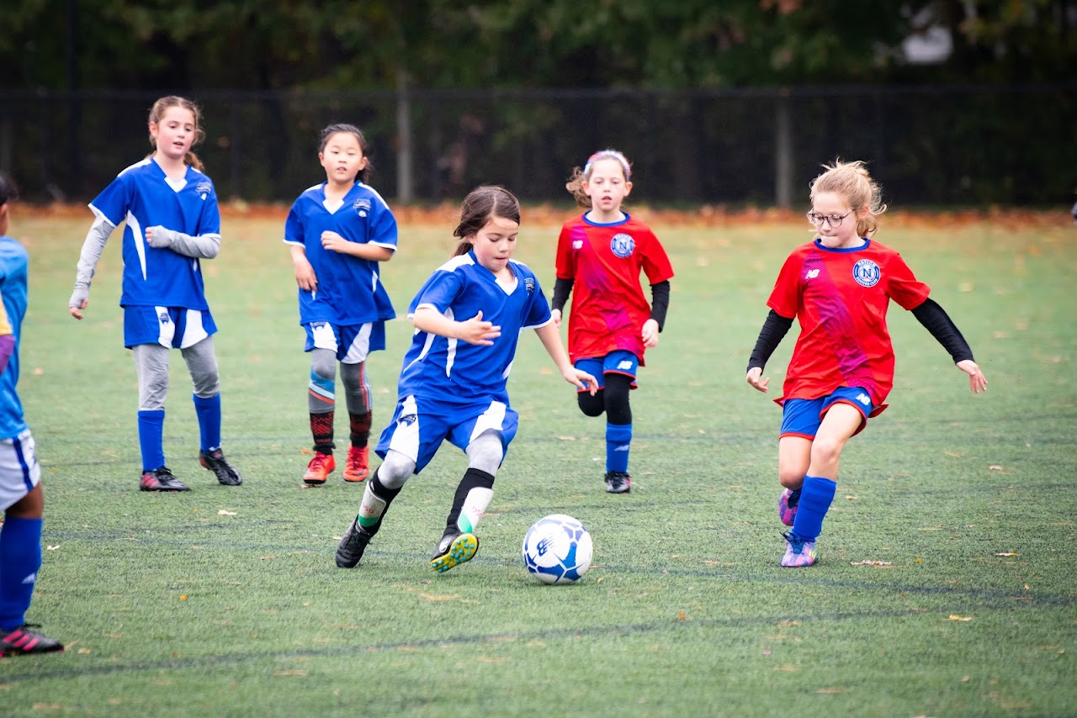
Travel Field assignments
Two practices per week and one game per weekend
Games Begin April 9 and end on June 11
Girls Practice Monday/Thursday
Boys Practice Tuesday/Friday
Boys
Girls
Age Group | Practice Location | Games
Boys Grade 3 (Koller) | South Road 7-9 | South Road 7-9
Boys Grade 3 (Gallant) | Springs Brook Park | Springs Brook Park
Boys Grade 3 (Iandiorio) | Springs Brook Park | Springs Brook Park
Boys Grade 4 (Kresser) | Lane School | Lane School
Boys Grade (Carroll/Lopez) | Lane School | Lane School
Boys Grade 5 (Fitzgerald) | South Road 7-9 (Front Field) | South Road 7-9 (Front Field)
`Boys Grade 6 (Parmentier) | South Road 9v9 (Back Field) | South Road 9v9 (Back Field)
Boys Grade 6 (Faulkner) | South Road 9v9 (Back Field) | South Road 9v9 (Back Field)
Boys Grade 8 (Kruger) | BHS Turf/Liljegren | BHS Turf/Liljegren
Boys Grade 8 (Rotella) | BHS Turf/Liljegren | BHS Turf/Liljegren
Boys Grade 8 (Dreyfus) | BHS Turf/Liljegren | BHS Turf/Liljegren
Age Group | Practice Location | Games
Girls Grade 3 (Toth) | Lane School | Lane School
Girls Grade 3 (Lyons) | Lane School | Lane School
Girls Grade 4 (Hurley) | Springs Brook Park | Springs Brook Park
Girls Grade 4 (Nair | Springs Brook Park | Springs Brook Park
Girls Grade 4 (Duffy) | South Road 7-9 (Front Field) | South Road 7-9 (Front Field)
Girls Grade 5 (Mancke) | South Road 7-9 (Front Field) | South Road 7-9 (Front Field)
Girls Grade 6 (Hybl) | South Road 9v9 (Back Field) | South Road 9v9 (Back Field)
Girls Grade 6 (Walton) | South Road 9v9 (Back Field) | South Road 9v9 (Back Field)
Girls Grade 8 (Ferguson) | BHS Turf/Liljegren | BHS Turf/Liljegren
Girls Grade 8 (Cullis) | BHS Turf/Liljegren | BHS Turf Liljegren

Slide 18
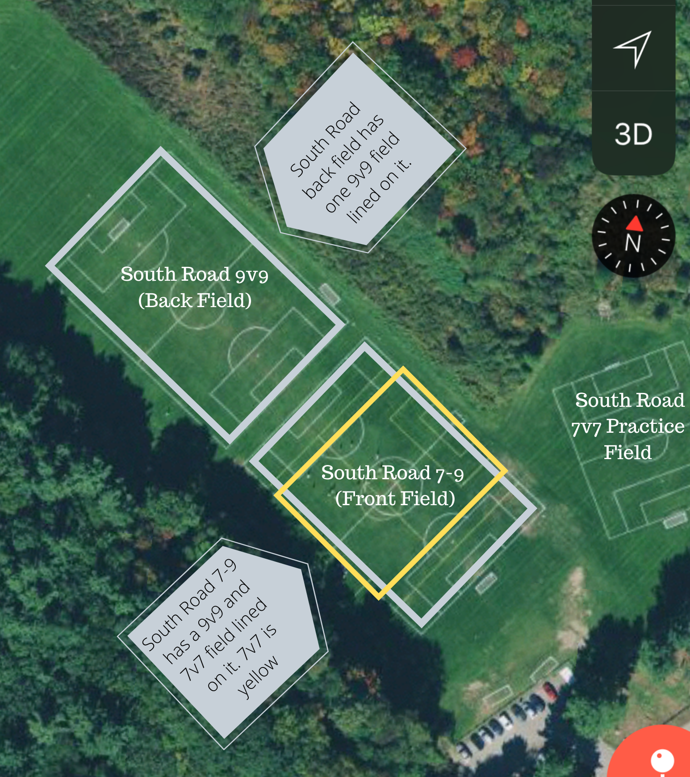
South Road
Field Set up
Please use this map to identify the South Road field set up.
South Road 9v9:
  Back Field
  Lined for 9v9 only
South Road 7-9
  Front Field(s)
  Lined for 9v9 (WHITE)
  Lined for 7v7 (YELLOW
  If you play 9v9 use the white vertical field
  If you play 7v7 use the yellow horizontal field
  Field has both sizes of goals at that location
South Road 7v7
  Too small for actual games but may be used for overflow practices
South Road Parking
For overflow parking, please park on Fayette Road, not South Road. Please inform teams/opponents of this.

Slide 19
Grade 7/8 Field Use
Practices: Grade 7/8 Teams have been assigned a combination of the BHS Turf Field & Liljegren Field for practices. The schedule is intended to be as equal as possible. (See next slide for schedule)
The BHS School team has some conflicts with the turf field over the season that will cause our program to be “bumped off the turf.” I will be in contact with you if there are any changes to the schedule below over the season.
Games:
Boys:
Games will be played on Liljegren or BHS Turf. Since there are three teams I will be doing my best to schedule the same amount of games on the turf for each team.
Girls:
  Games will be on the turf unless there is a conflict with the school

Slide 20
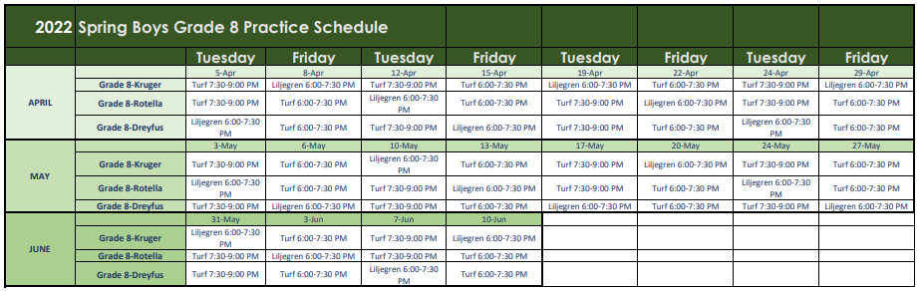
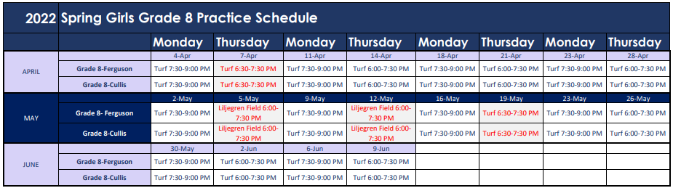

Slide 21
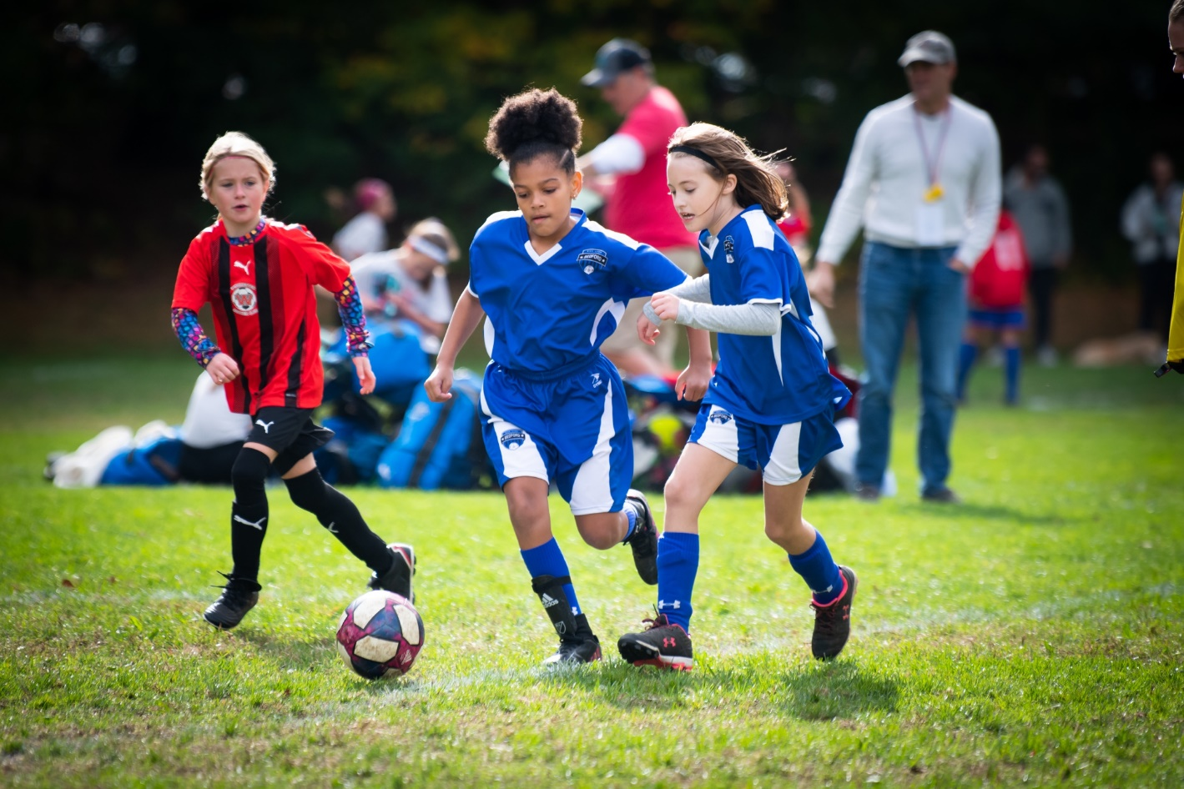
Equipment/Equipment Distribution
  Equipment pick up is Friday, March 25 from 5:00-6:00 PM at the Bedford Recreation Department (12 Mudge Way). Equipment pick up will be INSIDE. Please enter through the double green doors and come to the second floor.
    If you cannot make it during this time please contact Nikki to arrange an alternate time.
Each team will receive hand sanitizer & sanitizing wipes.
Shared equipment should be sanitized after each use.
Credentials and coaching shirts included in team bag if ready to be printed and ordered.
Coaches Shirts: Let me know by Friday at 8:00 AM what size coaches shirt you would like. Shirt sizes received by then will be included in your team bag.

Slide 22
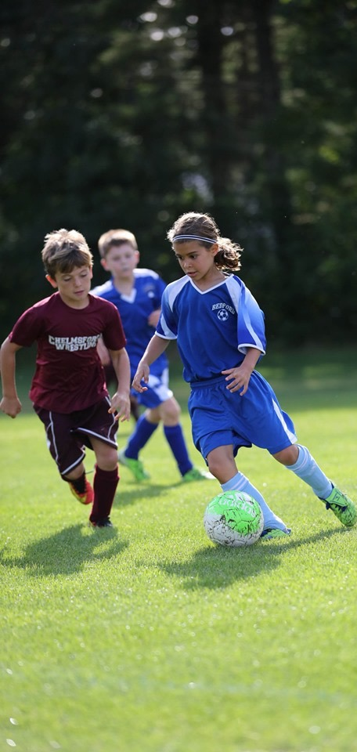

Coaching resources
Visit www.bedfordyouthsoccer.org for coaching resources
Nikki Taylor- Bedford Youth Soccer Liaison
Jason Rotella- Chair, Bedford Soccer Association
For weekend field closures/program cancellation due to weather please check our website at www.bedfordyouthsoccer.org
Age Group Coordinators (Grade 3-8):
  Girls Grade 3: Kevin Dickert
  Girls Grade 4: Jason Rotella
  Girls Grade 5/6: Heath Luedde
  Girls Grade 7/8: Kostia Franklin
  Boys Grade 3: Heath Luedde
  Boys Grade 4: Mary Gallant
  Boys Grade 5/6: Sean Walton
  Boys Grade 7/8: Damien Savoie

